Slide 1
Bridge Sampling for Connections via Multiple Scattering Events
Vincent Schüßler, Johannes Hanika, Carsten Dachsbacher

Slide 2
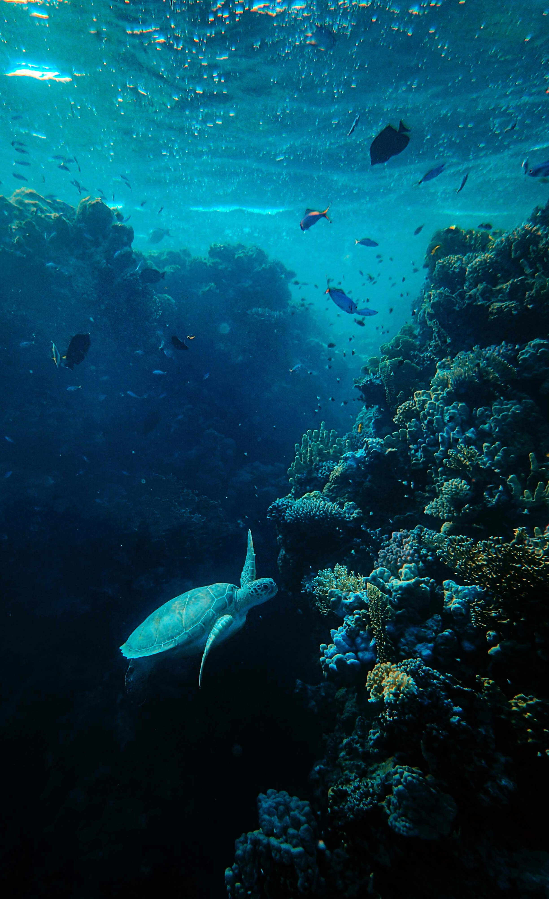
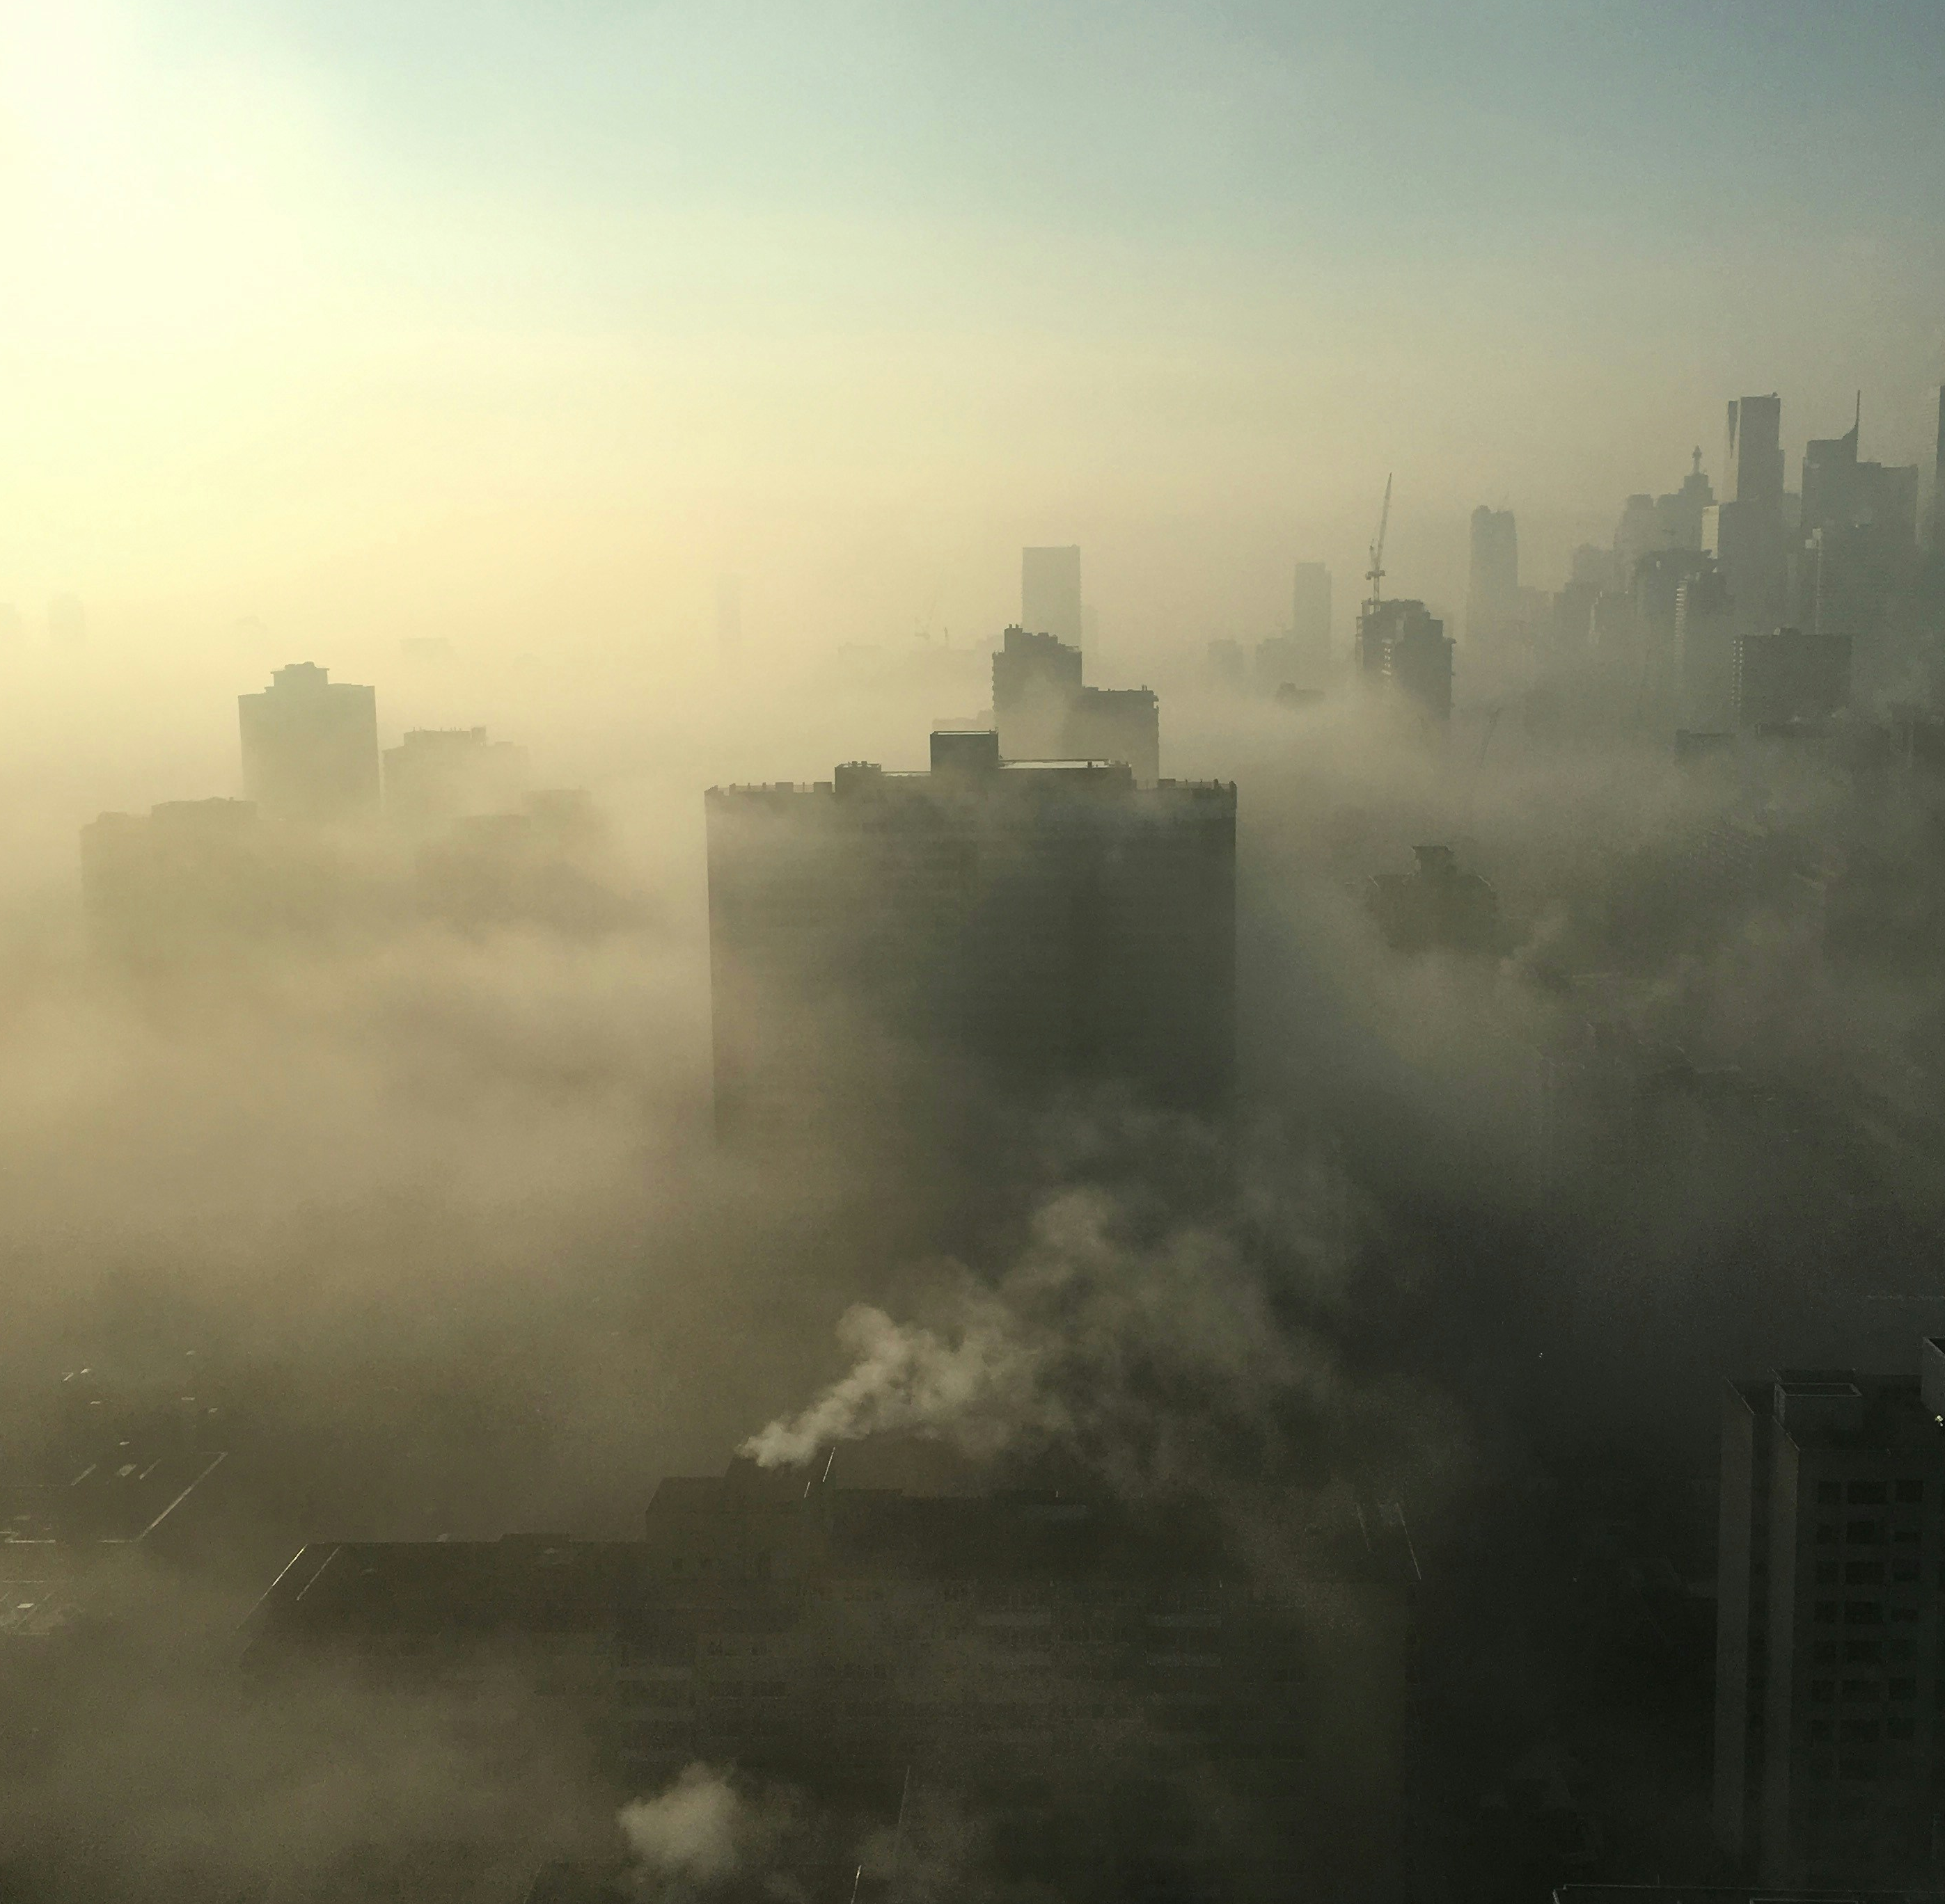
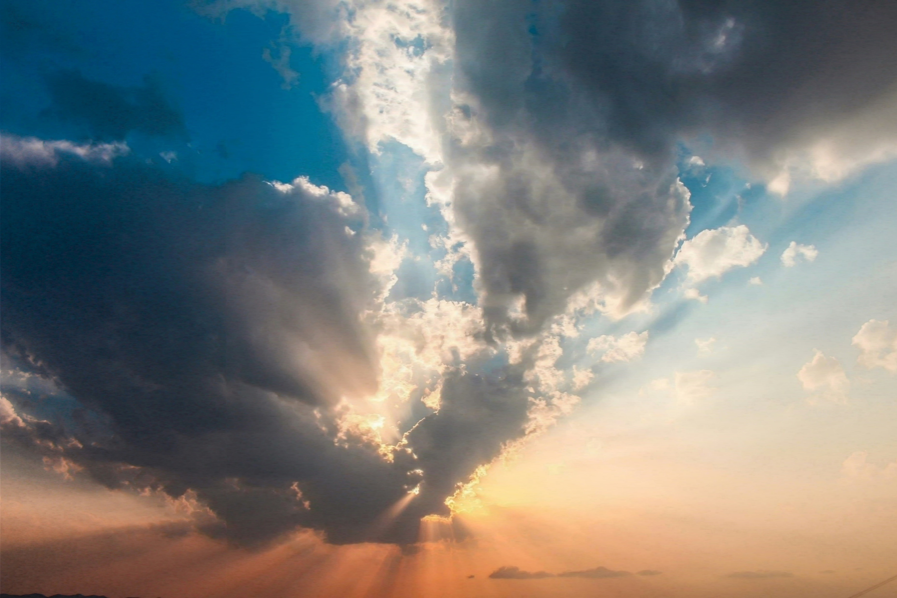
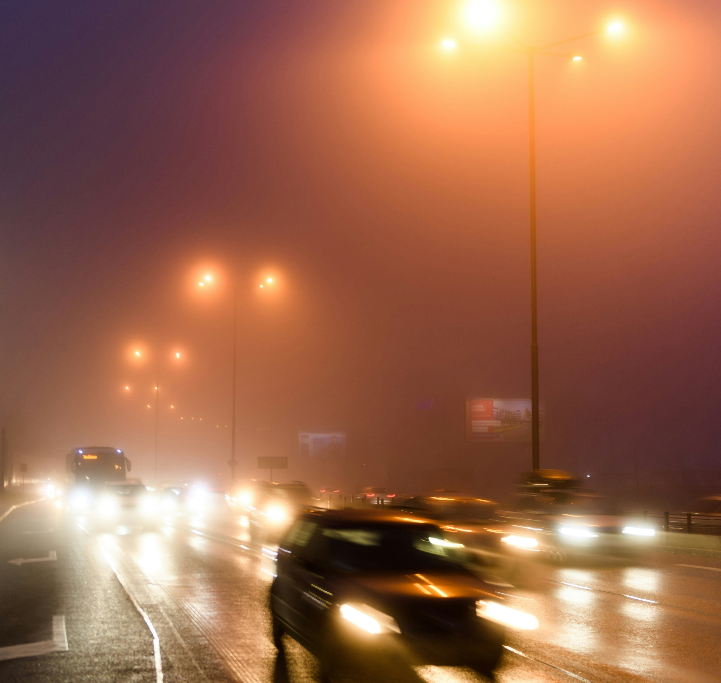
Forward-scattering media

Slide 3
Reference

Slide 4
Path tracing (1024 spp)

Slide 5
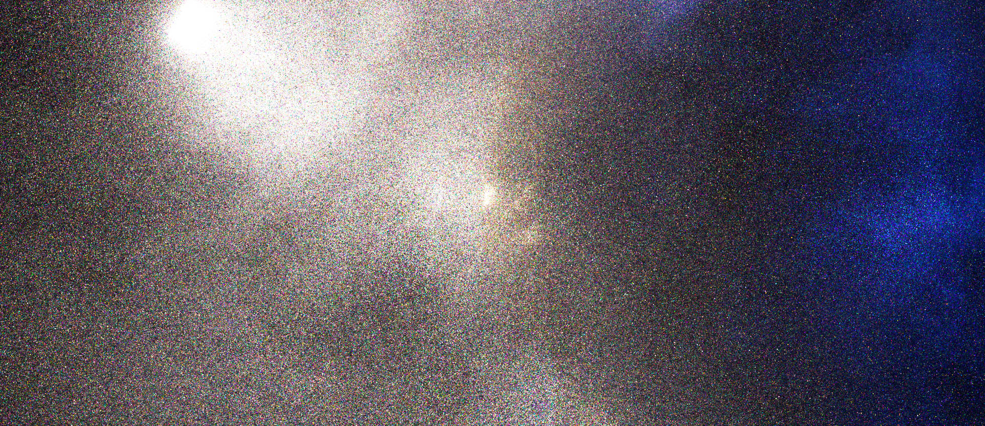
Ours (eq. time)

Slide 6
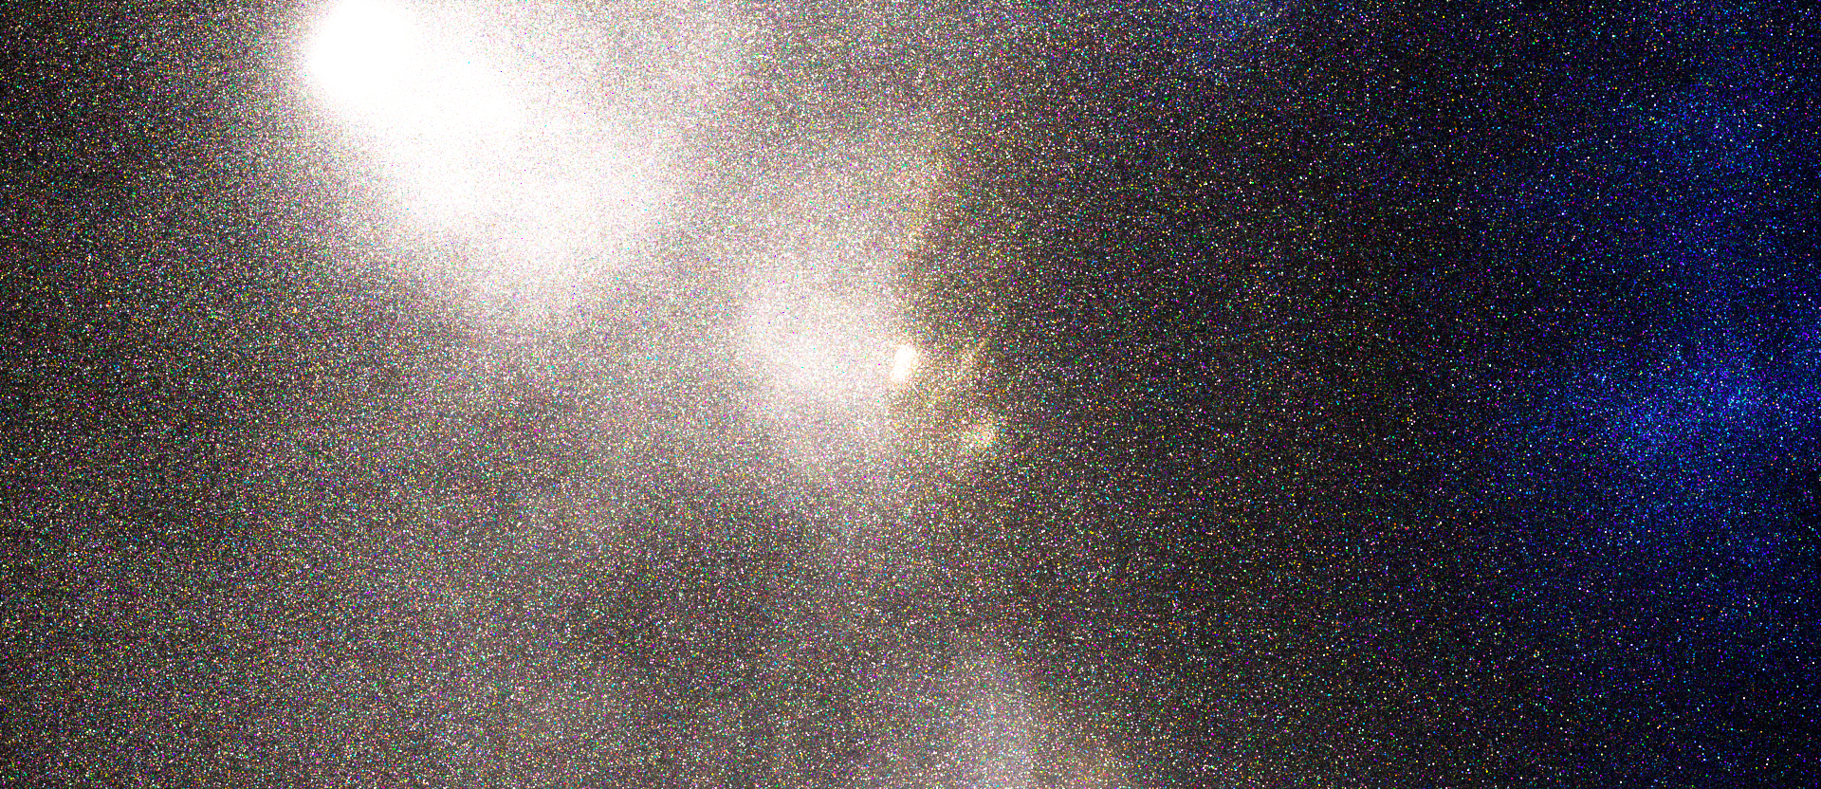
Path tracing (1024 spp)

Slide 7
Ours (eq. time)

Slide 8
Path tracing in media
$$I=\int_{𝒫}{f\left(\overline{x}\right) d\overline{x}}$$
phase
function
mean free
path $μ_{t}^{−1}$

Slide 9
Subpath connections
mean free paths $μ_{t}^{−1}$
4
5
6
7
8
9
10
11
12
13
$$I=\int_{𝒫}{f\left(\overline{x}\right) d\overline{x}}$$
phase
function
mean free
path $μ_{t}^{−1}$
bridge path
scatter order

Slide 10
Why explicit paths?
mean free paths $μ_{t}^{−1}$
4
5
6
7
8
9
10
11
12
13
high-order scattering:
diffused
medium-order scattering: visibility matters!
scatter order

Slide 11
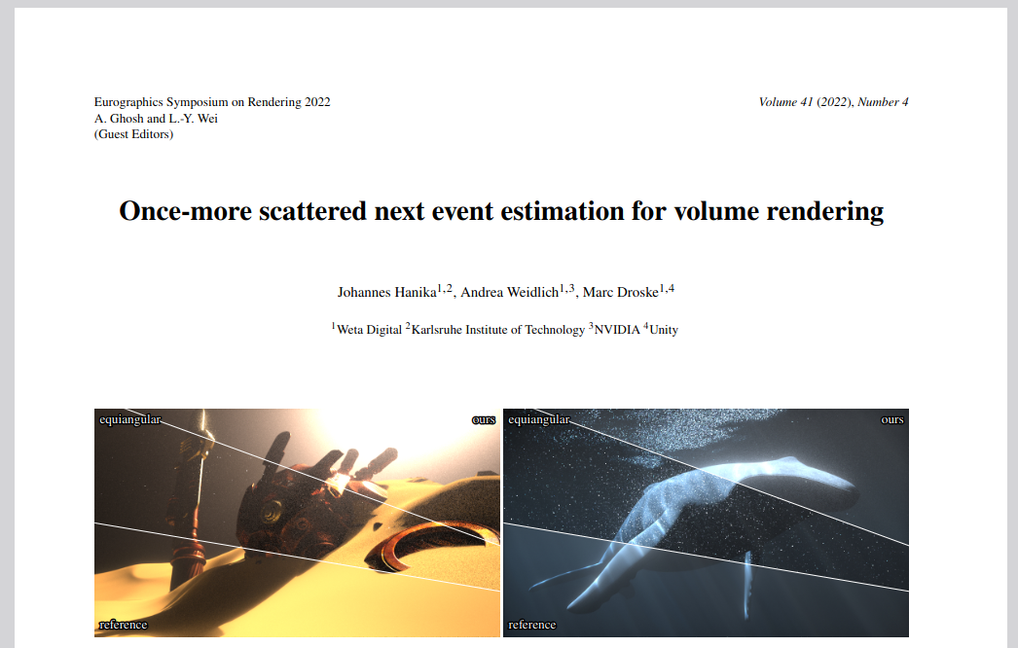
Single scattering
Challenges: $f= … G ρ G …$
phase function $ρ$
geometry terms $G=\frac{1}{d^{2}}$
phase function
$$d$$

Slide 12
OMNEE [Hanika et al. 2022]
1. sample phase function
2. sample point on arc
$$R$$

Slide 13
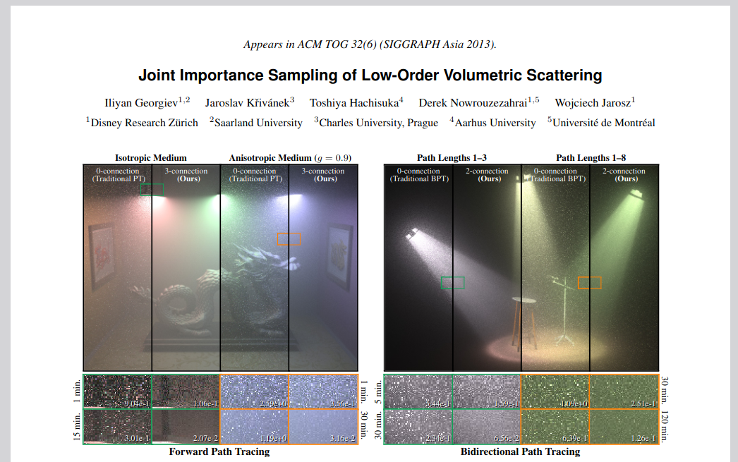
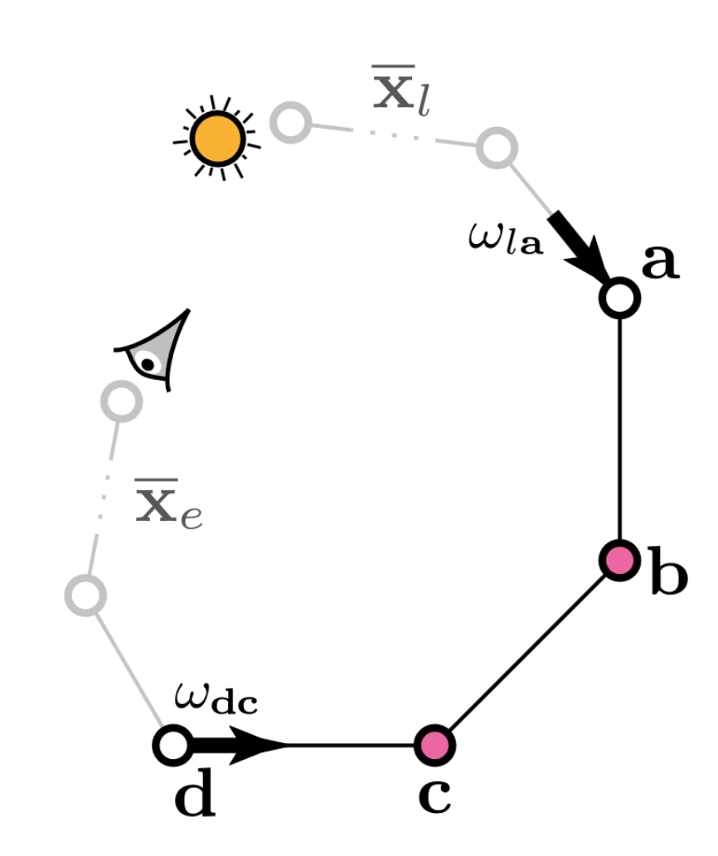
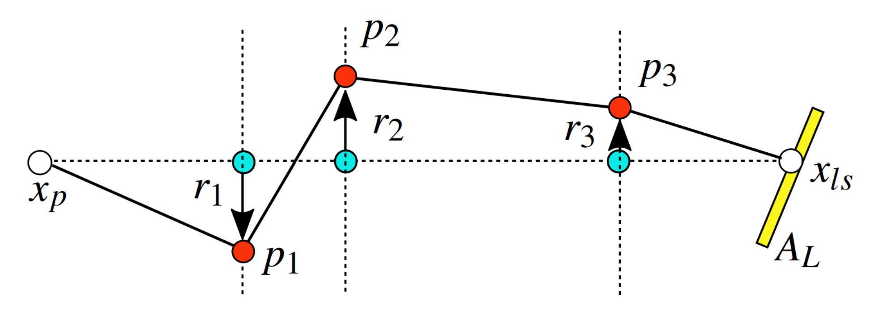
Multiple scattering
Double scattering [Georgiev et al. 2013]
MVNEE [Weber et al. 2017]

Slide 14
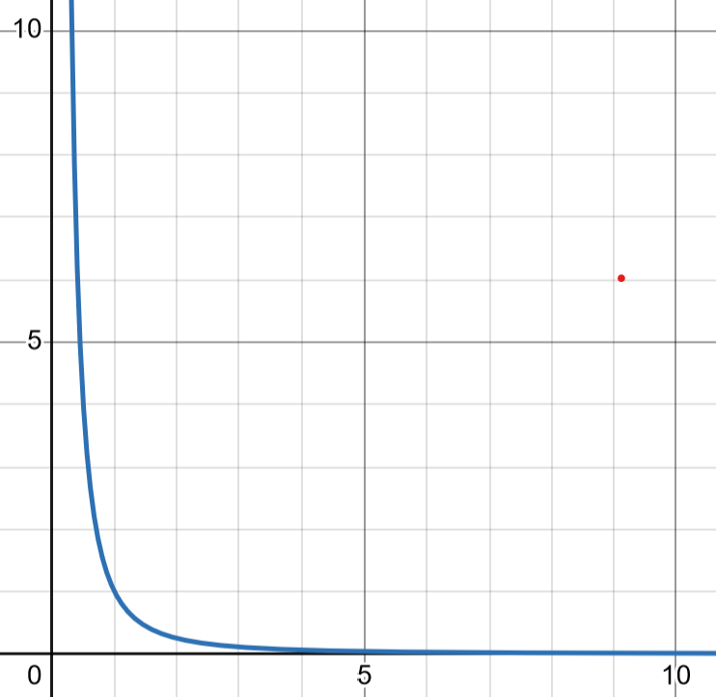
Our Goals
Support any vertex count
Explicit phase functions sampling
Importance sample geometry terms
...
$$G=\frac{1}{d^{2}}$$
$$d$$

Slide 15
Simple path tracing?
vertex count
phase functions
geometry terms
Idea: transform path!
$$≠$$
phase
function

Slide 16
Affine path transformation
bridge path
preliminary path

Slide 17
Probability density function (PDF)
product of ...
phase functions
$$p\left(\overline{x}′\right)=p\left(\overline{ω}′\right) p\left(\overline{d}′\right) \overline{G}$$
$$p\left(\overline{x}′\right) ↔ p\left(\overline{x}\right)$$
free flights
geo. terms
$$\overline{x}$$
preliminary path
bridge path
?
$$\overline{x}′$$
?
?
?
?
$n$ vertices
$n−1$ vertices

Slide 18
Bridge path PDF
1. Jacobian
bridge path
+ extra vertex $x_{n}^{′}$
$$p(\overline{x},x_{n}^{′})$$
$n$ vertices
preliminary path
$$p(\overline{x}′)$$
$$\overline{x}$$
?
$$\overline{x}′$$
$$n−1$$
vertices
2. marginal
$$\int{p(\overline{x},x_{n}^{′})}dx_{n}^{′}$$
$$=\int{p(\overline{x}′) \left|det{ J}_{(\overline{x},x_{n}^{′})→\overline{x}′}\right|dx_{n}^{′}}$$
bridge path
$$p(\overline{x})$$
$$x_{n}^{′}$$

Slide 19
Marginalization: reduction
$$\int{p(\overline{x}′) \left|det{ J}_{(\overline{x},x_{n}^{′})→\overline{x}′}\right|dx_{n}^{′}}$$
$⇒$ reduces to 1D integral $\int{…}dr$
$$s$$
$$\overline{x}$$
$$\overline{x}′$$
$$x_{n}^{′}$$
$$r$$

Slide 20
Marginalization: 1D integral
free-flight sampling
$$⋯\int_{0}^{∞}{\left(\prod_{i=1}^{n}{\exp\left(−r d_{i}⋯\right)}\right)r^{n−1}dr}$$
$$=⋯\int_{0}^{∞}{\exp\left(−r⋯\sum_{i=1}^{n}{d_{i}}\right) r^{n−1}dr}$$
$$=\frac{s^{3}\left(n−1\right)!}{{\left(\sum_{i=1}^{n}{d_{i}}\right)}^{n}}$$
$$s$$
$$d_{4}$$
$$d_{1}$$
$$d_{3}$$
$$d_{2}$$
$$r$$

Slide 21
Results
Equiangular
[Kulla et al. 2012]
RMSE
RMSE
MVNEE
[Weber et al. 2017]
OMNEE
[Hanika et al. 2022]
Bridges
Ours
RMSE
RMSE

Slide 22
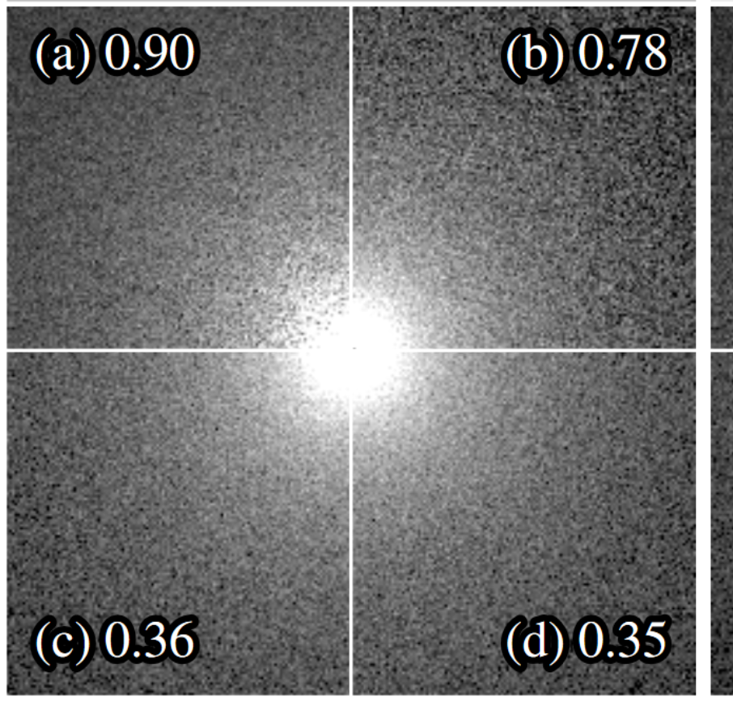
Single scattering, mean cos $0.5$
phase function
Equiangular
[Kulla et al. 2012]
MVNEE
[Weber et al. 2017]
OMNEE
[Hanika et al. 2022]
Bridges
Ours

Slide 23
Single scattering, mean cos $0.7$
phase function
Equiangular
[Kulla et al. 2012]
MVNEE
[Weber et al. 2017]
OMNEE
[Hanika et al. 2022]
Bridges
Ours

Slide 24
Single scattering, mean cos $0.9$
phase function
Equiangular
[Kulla et al. 2012]
MVNEE
[Weber et al. 2017]
OMNEE
[Hanika et al. 2022]
Bridges
Ours

Slide 25
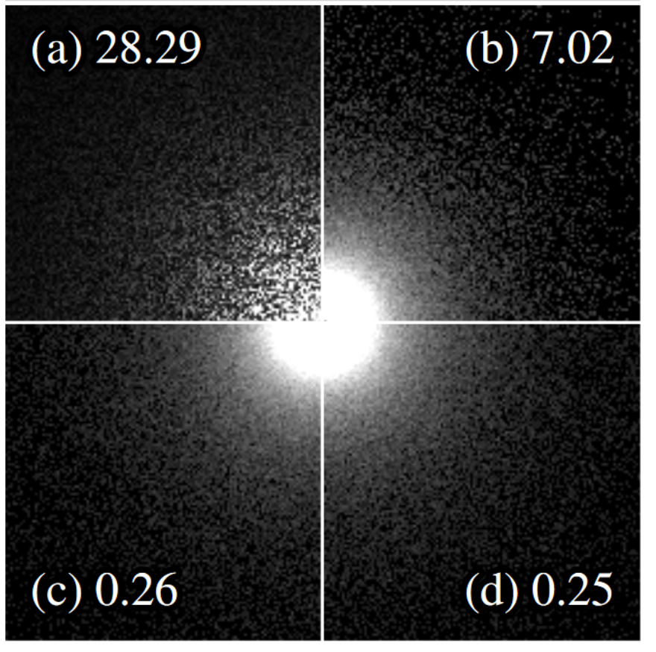
Single scattering, mean cos $0.98$
phase function
Equiangular
[Kulla et al. 2012]
MVNEE
[Weber et al. 2017]
OMNEE
[Hanika et al. 2022]
Bridges
Ours

Slide 26
Mean cos $0.95$, path length 3
phase function
Equiangular
[Kulla et al. 2012]
MVNEE
[Weber et al. 2017]
OMNEE
[Hanika et al. 2022]
Bridges
Ours

Slide 27
Mean cos $0.95$, path length 4
phase function
Equiangular
[Kulla et al. 2012]
MVNEE
[Weber et al. 2017]
OMNEE
[Hanika et al. 2022]
Bridges
Ours

Slide 28
Mean cos $0.95$, path length 5
phase function
Equiangular
[Kulla et al. 2012]
MVNEE
[Weber et al. 2017]
OMNEE
[Hanika et al. 2022]
Bridges
Ours

Slide 29
Mean cos $0.95$, path length 6
phase function
Equiangular
[Kulla et al. 2012]
MVNEE
[Weber et al. 2017]
OMNEE
[Hanika et al. 2022]
Bridges
Ours

Slide 30
Mean cos $0.95$, path length 7
phase function
Equiangular
[Kulla et al. 2012]
MVNEE
[Weber et al. 2017]
OMNEE
[Hanika et al. 2022]
Bridges
Ours

Slide 31
Mean cos $0.95$, path length 8
phase function
Equiangular
[Kulla et al. 2012]
MVNEE
[Weber et al. 2017]
OMNEE
[Hanika et al. 2022]
Bridges
Ours

Slide 32
Long paths: length 20, 50, 100

Slide 33
Bridge vertex count
mean free paths $μ_{t}^{−1}$
4
5
6
7
8
9
10
11
12
13

Slide 34
Free-flight sampling: Poisson process
mean free paths $μ_{t}^{−1}$
4
5
6
MVNEE and delta tracking
sample Poisson distribution $P_{λ}$? [Georgiev et al. 2019]
optical thickness $λ=μ_{t} s$
$$s$$
track length

Slide 35
Problem: bridge “detour”
mean free paths $μ_{t}^{−1}$
4
5
6
our track length $≥s$
depends on
sampled directions
vertex count ↯
$$s$$

Slide 36
Our approach
$$ℬ = B_{1} + B_{2} + B_{3} + ⋯$$
eval. $B_{i}$with probability $∼\sqrt{𝔼\left[B_{i}^{2}\right]}$ [Vévoda et al. 2018]

Slide 37
Precomputation
Simplifications
homogeneous medium
directions $↔$ phase function parameters
$⇒$ 1D function of optical thickness

Slide 38
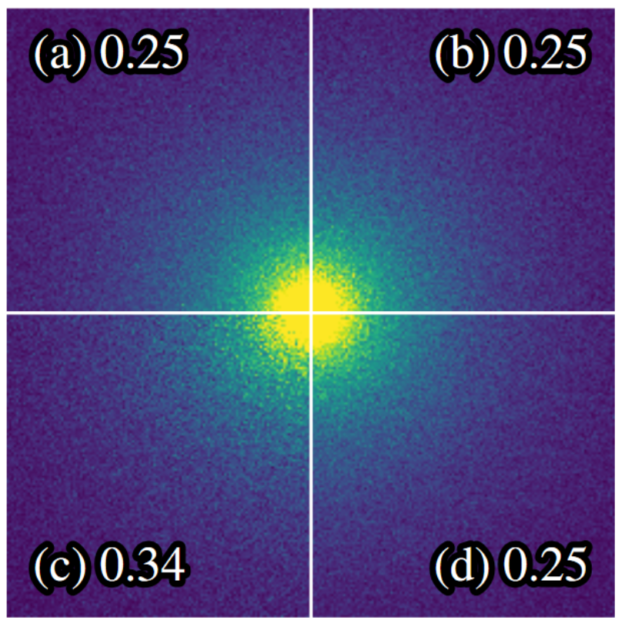
Mean cos $0.9$, path length 3 to 10
Poisson
Ours
first moment
Poisson
$$×1.5$$
Ours
second moment

Slide 39
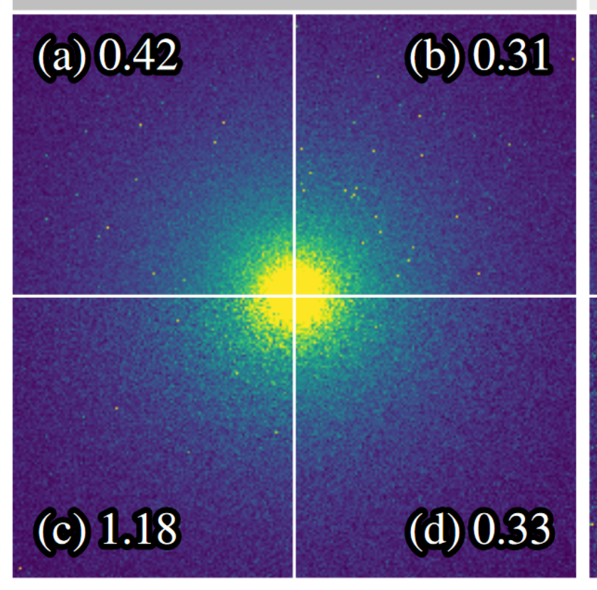
Mean cos $0.9$, path length 3 to 30
Poisson
Ours
first moment
Poisson
$$×1.5$$
Ours
second moment

Slide 40
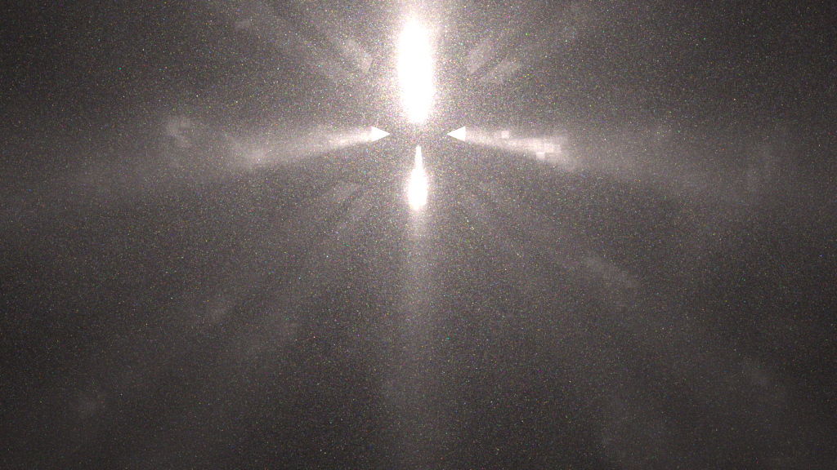
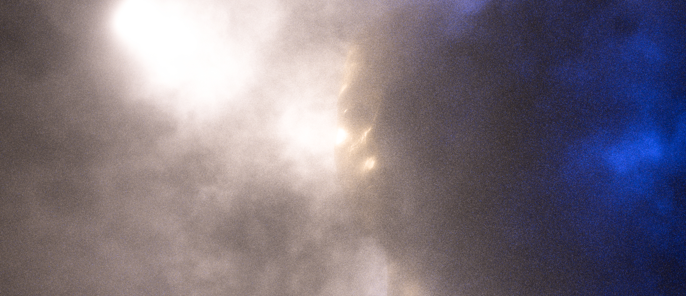
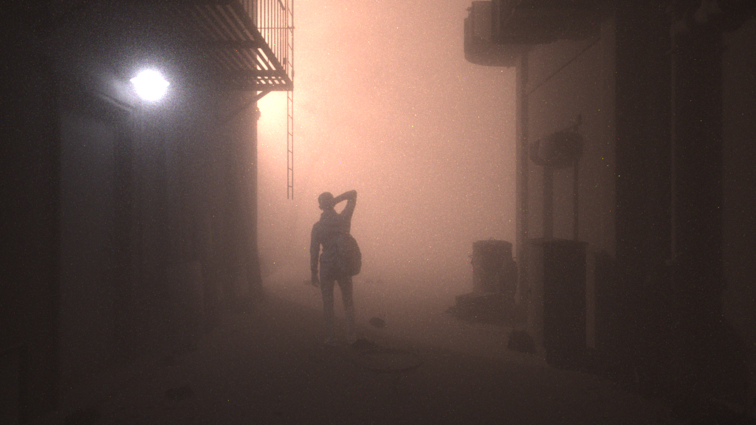
More in the paper
renderer integration
constraint-based sampling
equivalent to OMNEE
single/double scattering

Slide 41
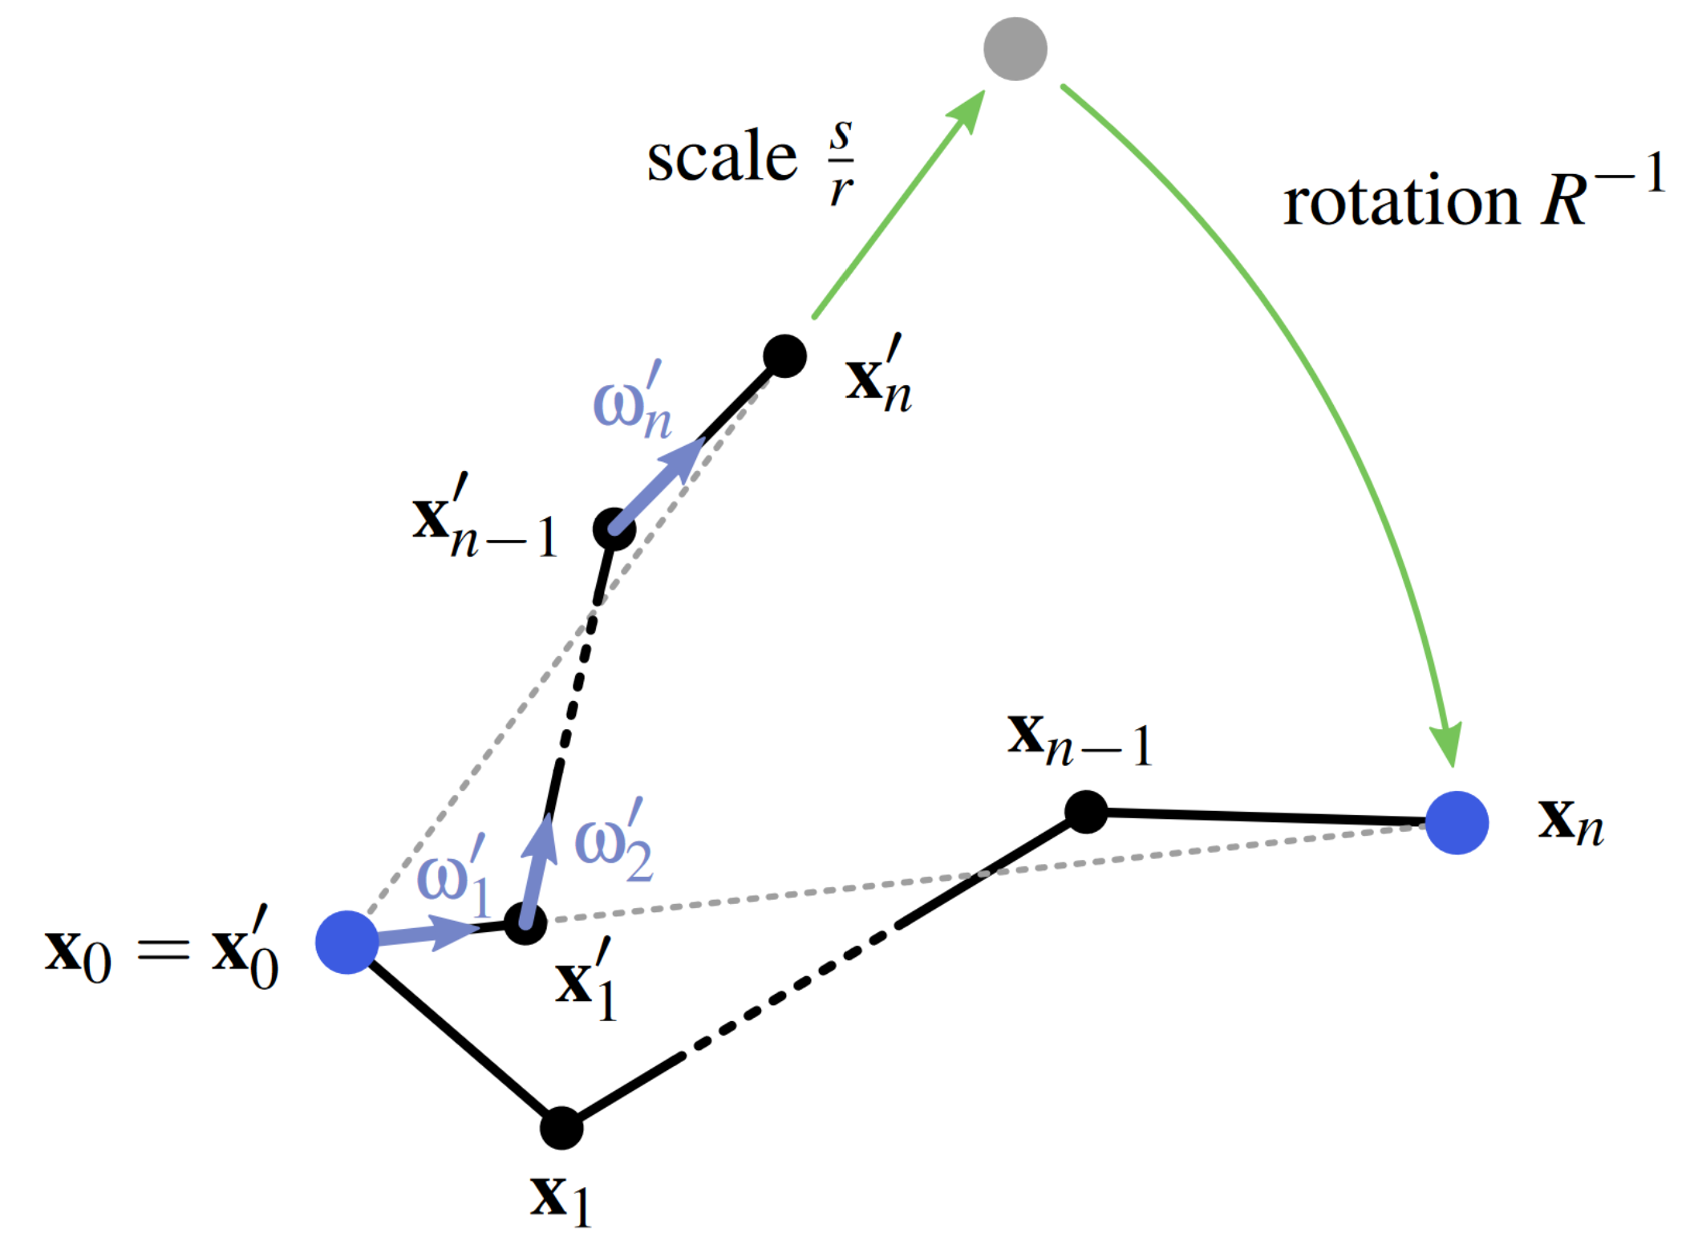
Conclusion
Sample connecting subpath in medium
any vertex count
phase functions, geo. terms
simple
Future work
better sampling of vertex count
bidirectional path tracing
Thank you!

