Slide 1
Optimizing Path Termination for Radiance Caching Through Explicit Variance Trading
Lukas Kandlbinder, Addis Dittebrandt, Alexander Schipek, Carsten Dachsbacher
HPG’24

Slide 2
Real-Time Path Tracing
Path Tracer (1spp)
+ SVGF

Slide 3
Radiance Caching – Primary .
Path Tracer + Radiance Cache (1spp)
+ SVGF

Slide 4
Path Termination – Secondary .
Path Tracer + Radiance Cache (1spp, 2nd vertex)
+ SVGF

Slide 5
Path Termination – Area-Spread Heuristic .
Müller et al. 2021, Bekaert et al. 2003 .
Path Tracer + Radiance Cache (1spp, Area-Spread)
+ SVGF

Slide 6
Denoiser Behavior Towards Noise
Goal: Explicitly control image variance

Slide 7
Overview
Variance Bounding
MSE Minimization

Slide 8
Common Approach
Optimize global target through local decisions
Exploit monotonicity of expectation operator:
$$\underbrace{X≤Y} ⇒\underbrace{E\left[X\right]≤E\left[Y\right]}$$
In our case: path space expectation $E[X]$
local decision
global target

Slide 9
Overview
Variance Bounding
MSE Minimization

Slide 10
Approach
Global target
$$V\left[g\right]≤c⟺E\left[X\right]≤E\left[Y\right]$$
But:
$$V\left[X\right]≠E\left[ ⋅ \right]$$
$$V\left[X\right]=E{\left[X\right]}^{2}−E\left[X^{2}\right]≠E\left[ ⋅ \right]$$

Slide 11
Terminology
$$g$$
$${prefix}_{j}$$
$${suffix}_{j}$$
$$x_{j}$$
$$\overline{g}$$

Slide 12
Reformulating Variance
$$g$$
$${prefix}_{j}$$
$${suffix}_{j}$$
$$x_{j}$$
$$\overline{g}$$
$$V\left[g\right]=E\left[\sum_{j=0}^{∞}{{prefix}_{j}^{2}⋅VE[{suffix}_{j}|x_{j+1}]}\right]$$
$$x_{2}$$
$$V$$
$$x_{0}$$
$$…$$
$$V$$
Full Derivation: Paper Section 4.1
$$V\left[aX\right]=a^{2}V[X]$$
$$x_{1}$$

Slide 13
Reformulating Variance
$$g$$
$${prefix}_{j}$$
$${suffix}_{j}$$
$$x_{j}$$
$$\overline{g}$$
$$V\left[g\right]=E\left[\sum_{j=0}^{∞}{{prefix}_{j}^{2}⋅VE[{suffix}_{j}|x_{j+1}]}\right]$$
$$E$$
$$E$$
$$E$$
$$E$$
$$x_{0}$$
$$x_{1}$$

Slide 14
Local Variance Estimation
$E\left[X\right]$ already in radiance cache at next vertex
Store second moment $E[{E\left[{\text{suffix}}_{j}|x_{j+1}\right]}^{2}]$
$$cache≈E[suffix_{j+1}]$$
$$E$$
$$E$$
$$E$$
$$E$$
Radiance Cache Cell
Local Variance:
$$V_{j}≈VE\left[suffix_{j} | x_{j+1}\right]$$
Query Vertex
$$x_{j}$$

Slide 15
Reformulating Variance
$$g$$
$${prefix}_{j}$$
$${suffix}_{j}$$
$$x_{j}$$
$$\overline{g}$$
$$V\left[g\right]=E\left[\sum_{j=0}^{∞}{{prefix}_{j}^{2}⋅{\text{V}}_{j} }\right]$$
$$x_{2}$$
$$V_{2}$$
$$x_{0}$$
$$…$$
$$V_{1}$$
$$x_{1}$$

Slide 16
Reformulating Variance
$$g$$
$${prefix}_{j}$$
$${suffix}_{j}$$
Terminate into radiance
cache after $N$ bounces
$$x_{j}$$
$$\overline{g}$$
$$V\left[\overline{g} \right]=E\left[\sum_{j=0}^{N}{{prefix}_{j}^{2}⋅{\text{V}}_{j} }\right]\overset{!}{≤}c$$
$$X≤c⇔E\left[X\right]≤c$$
$$x_{2}$$
$$V_{2}$$
$$x_{0}$$
$$…$$
$$V_{1}$$
$$x_{1}$$

Slide 17
Algorithm
attenuated
Accumulate attenuated local variance until threshold is reached
Interpolate to reach exact threshold:
$$\overline{g}≈\left(1−α\right) \text{prefi}{\text{x}}_{\text{3}} \text{cach}{\text{e}}_{\text{3}}$$
$$+ α \text{prefi}{\text{x}}_{\text{4}} \text{cach}{\text{e}}_{\text{4}}$$
$$\overline{g}≈\text{prefi}{\text{x}}_{\text{3}} \text{cach}{\text{e}}_{\text{3}}$$
$$V_{1}+f_{1}^{2}V_{2}≤c$$
$$V_{2}$$
$$α=\sqrt{\frac{c −\left(V_{1}+f_{1}^{2}V_{2}\right)}{f_{1}^{2}f_{2}^{2}V_{3}}}$$
$$f_{1}^{2}f_{2}^{2}V_{3}$$
$$f_{1}$$
$$f_{2}$$
$$V=c$$
$$c −\left(V_{1}+f_{1}^{2}V_{2}\right)$$
$$V_{1}$$
$$V_{3}$$
$$V_{1}≤c$$
$$V_{1}+f_{1}^{2}V_{2}+f_{1}^{2}f_{2}^{2}V_{3}>c$$

Slide 18
Discrete Analogue of Path Tracer
Camera
Primary
Secondary
Tertiary
Low Variance
High Variance

Slide 19
Real Path Tracer – Variance Bounding .
Variance Bound .

Slide 20
Application to Path Tracer

Slide 21
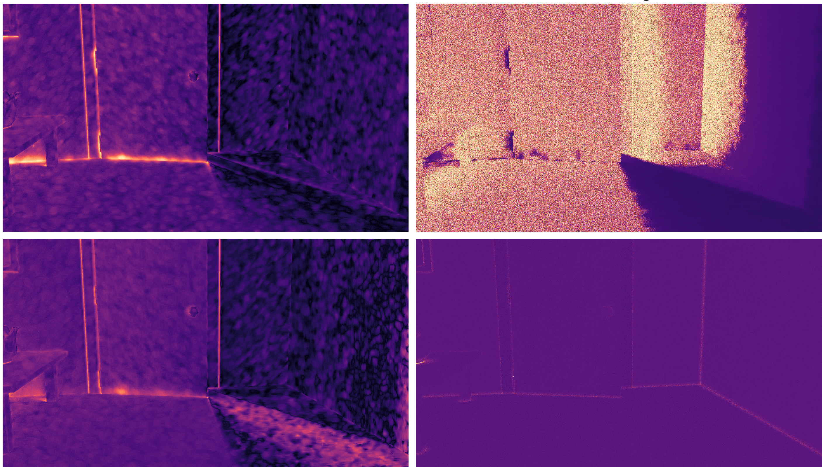
Comparison to Area-Spread

Slide 22
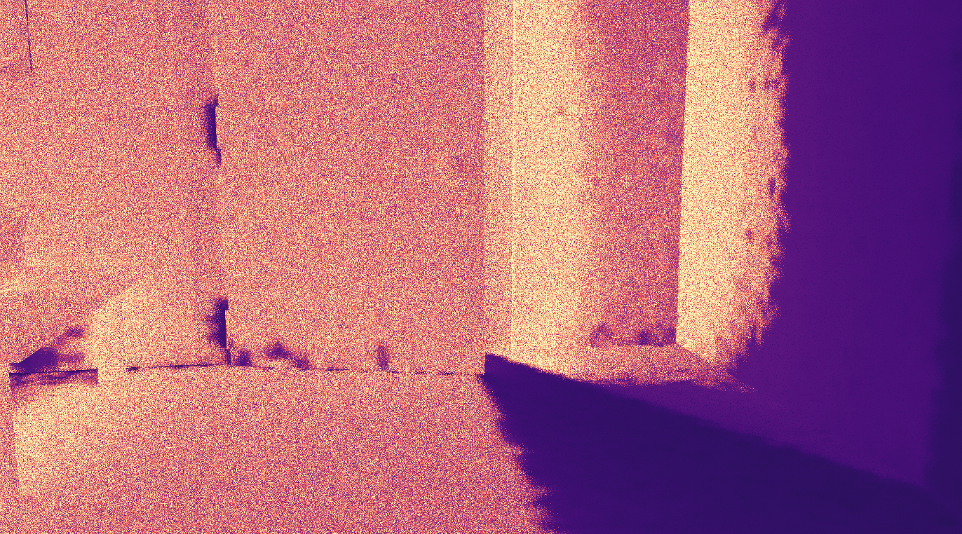
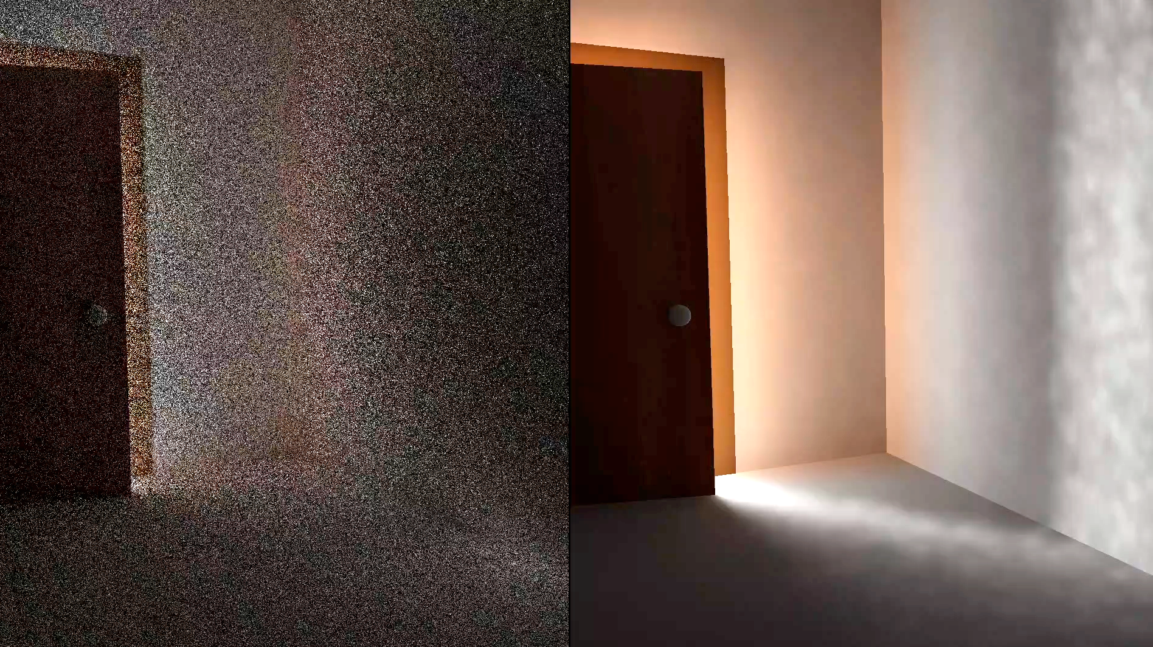
Discussion
Path length is maximized whether necessary or not
Early termination sometimes completely sufficient
Variance Bounding – Path Length
Secondary Termination (+ SVGF)

Slide 23
Overview
Variance Bounding
MSE Minimization

Slide 24
Approach
$$g$$
$${prefix}_{j}$$
$${suffix}_{j}$$
$$x_{j}$$
$$\overline{g}$$
Termination with minimal MSE for sample count $N$
$${\text{MSE}}_{N}\left(\overline{g},E\left[g\right]\right)\text{ = }\frac{V\left[\overline{g}\right]}{N}+\text{Bias}{\left(\overline{g},E\left[g\right]\right)}^{2}$$
$${\text{MSE}}_{N}\left({\overline{g}}_{1},E\left[g\right]\right)≤{\text{MSE}}_{N}\left({\overline{g}}_{2}, E\left[g\right]\right)⟺E\left[X\right]≤E\left[Y\right]$$

Slide 25
Approach
$$g$$
$${prefix}_{j}$$
$${suffix}_{j}$$
$$x_{j}$$
$$\overline{g}$$
$$\text{Bias}{\left(\overline{g},E\left[g\right]\right)}^{2}≤E\left[{\text{prefix}}^{2}∙{\underbrace{\left(\text{cache}−E\left[\text{suffix}\right]\right)}}^{2}\right]$$
Local Bias
$$\overline{g}$$
$$g$$

Slide 26
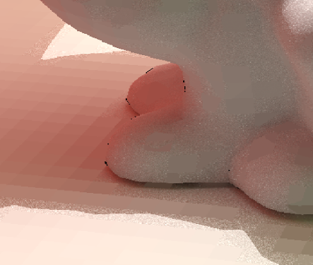
Local Bias Estimation
$$g$$
$${prefix}_{j}$$
$${suffix}_{j}$$
$$x_{j}$$
$$\overline{g}$$
Estimate average local bias in cache record
$$E\left[\text{Bias}{\left(\text{cache},E\left[\text{suffix} | x\right]\right)}^{2}\right]=\underbrace{E\left[E{\left[\text{suffix} | x\right]}^{2}\right]}−\underbrace{E{\left[\text{suffix}\right]}^{2}}$$
Marginal Second Moment
First Moment
$$x_{1}$$

Slide 27
Squared Expectations
$$g$$
$${prefix}_{j}$$
$${suffix}_{j}$$
$$x_{j}$$
$$\overline{g}$$
$E\left[E{\left[\text{suffix} | x\right]}^{2}\right]=E[{\text{suffix}}_{1}|x⋅{\text{suffix}}_{2}|x]$
High variance
Offset by creating set of independent samples
Sum of all pair products (scales quadratically)
Distribute computation over subgroup
$$x$$
 | $$X_{1}$$ | $$X_{2}$$ | $$X_{3}$$ |  | $$X_{n}$$
$$X_{1}$$
$$X_{2}$$
$$X_{3}$$
$$X_{n}$$

Slide 28
Bias Estimation
Low Bias
High Bias

Slide 29
Squared Expectations
$$g$$
$${prefix}_{j}$$
$${suffix}_{j}$$
$$x_{j}$$
$$\overline{g}$$
$E\left[E{\left[\text{suffix} | x\right]}^{2}\right]=E[{\text{suffix}}_{1}|x⋅{\text{suffix}}_{2}|x]$
High variance!
Offset by creating set of independent samples
Sum of all pair products (scales quadratically)
Distribute computation over subgroup
$$x$$
 | $$X_{1}$$ | $$X_{2}$$ | $$X_{3}$$ |  | $$X_{n}$$
$$X_{1}$$
$$X_{2}$$
$$X_{3}$$
$$X_{n}$$

Slide 30
Equal-Time Convergence of Bias Estimation
$2$ Ind. Samples
1 Pair
$32$ Ind. Samples
496 Pairs
${256}^{2}$ Samples
32640 Pairs
Low Bias
High Bias

Slide 31
Termination Algorithm
Continue until local minima is found
„Lookahead“ to know if minima
Depends on target sample count

Slide 32
Discrete Analogue of Path Tracer
Bias
Camera
Variance
Primary
Secondary
Tertiary
Low
High

Slide 33
Discrete Analogue of Path Tracer
Bias
Camera
Variance
Primary
Secondary
Tertiary
Low
High

Slide 34
Discrete Analogue of Path Tracer
Bias
Camera
Variance
Primary
Secondary
Tertiary
Low
High

Slide 35
Discrete Analogue of Path Tracer
Bias
Camera
Variance
Primary
Secondary
Tertiary
$$\text{Bias}{\left(\overline{g},E\left[g\right]\right)}^{2}≤E\left[{\text{prefix}}^{2}∙{\left(\text{cache}−E\left[\text{suffix}\right]\right)}^{2}\right]$$
Low
High

Slide 36
Path Tracer .
Sample Target

Slide 37
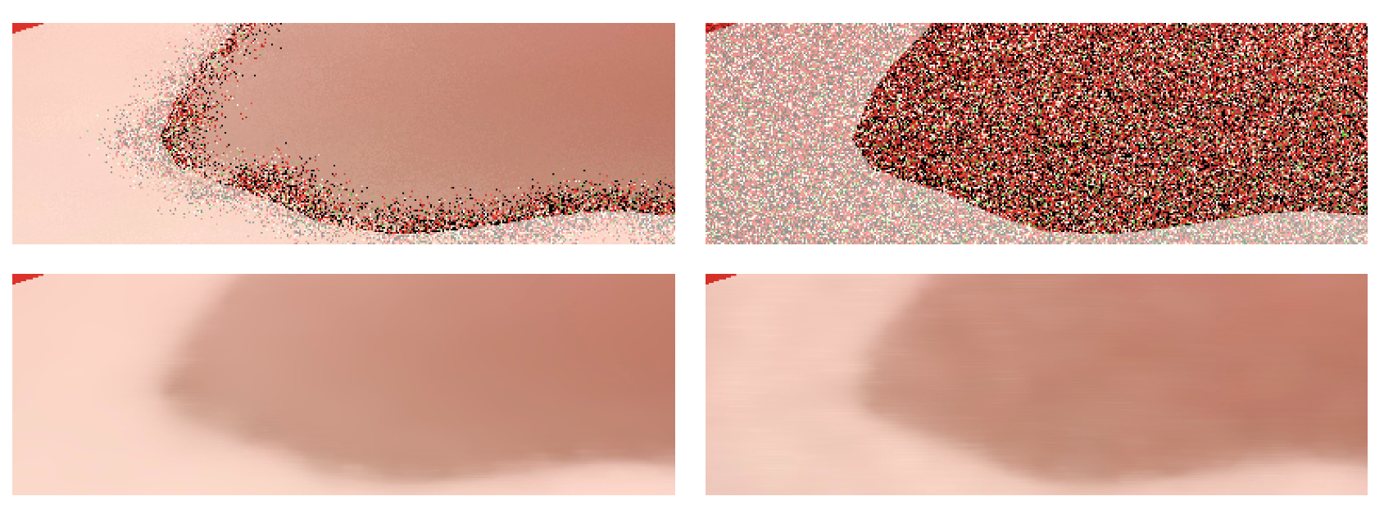
Comparison
MSE Min. (Ours)
Area-Spread
1 spp
SVGF

Slide 38
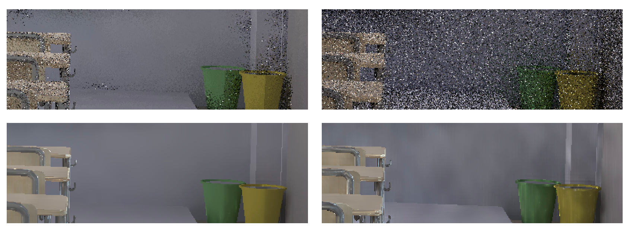
Comparison
MSE Min. (Ours)
Area-Spread
1 spp
SVGF

Slide 39
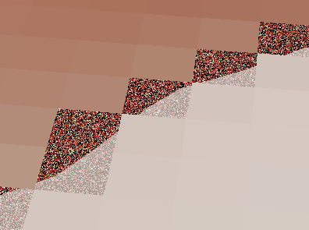
Discussion
Gradient Bias
Positivization
$$\text{Bias}{\left(\overline{g},E\left[g\right]\right)}^{2}≤E\left[{\text{prefix}}^{2}∙{\left(\text{cache}−E\left[\text{suffix}\right]\right)}^{2}\right]$$

Slide 40
Overview
Variance Bounding
MSE Minimization

