Slide 1
Stochastic Subsets for BVH Construction
Lorenzo Tessari* ¹, Addis Dittebrandt* ^{1, 2}, Michael Doyle¹, Carsten Benthin¹
¹Intel, ²KIT
EUROGRAPHICS 2023
*joint first authorship

Slide 2
Ray Tracing
Use cases: Primary Visibility, NEE, Path Tracing, …
Notes:
Ray tracing: closest hit from given starting point and direction

Slide 3
Bounding Volume Hierarchies (BVHs)
Notes:
Hierarchical bounding
Encompass primitives

Slide 4
BVH Traversal
Notes:
Only

Slide 5
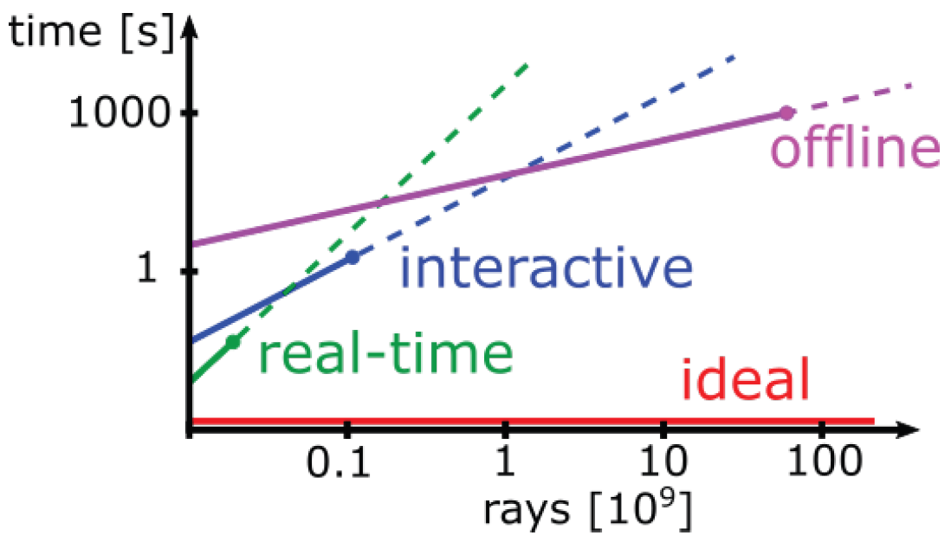
BVH Construction
Tradeoff between build time & quality/traversal efficiency
General goal: Better quality in less build time
Targeted for GPUs
[Meister et al. 2021]

Slide 6
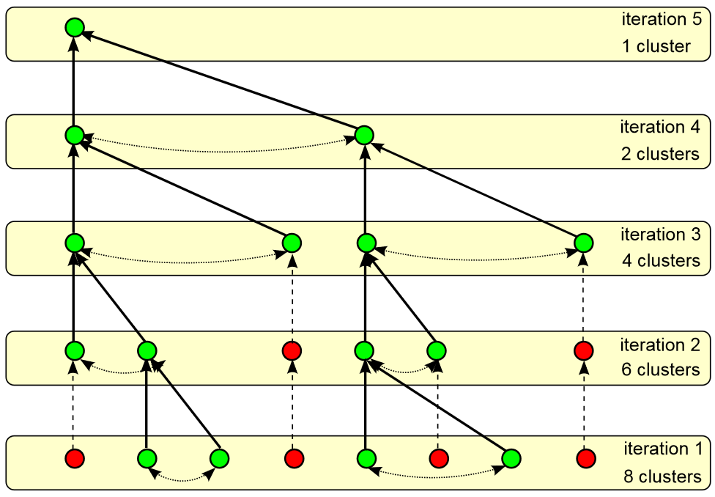
Previous Work
Top-Down
Top-Down
Binning [Wald 2007]
Progressive Refinement [Jakub et al. 2017]
Bottom-Up
Agglomerative clustering [Walter et al. 2008]
Parallel locally ordered clustering (PLOC) [Meister and Bittner 2017]
PLOC++ [Benthin et al. 2022]
$$⋯$$
PLOC / PLOC++

Slide 7
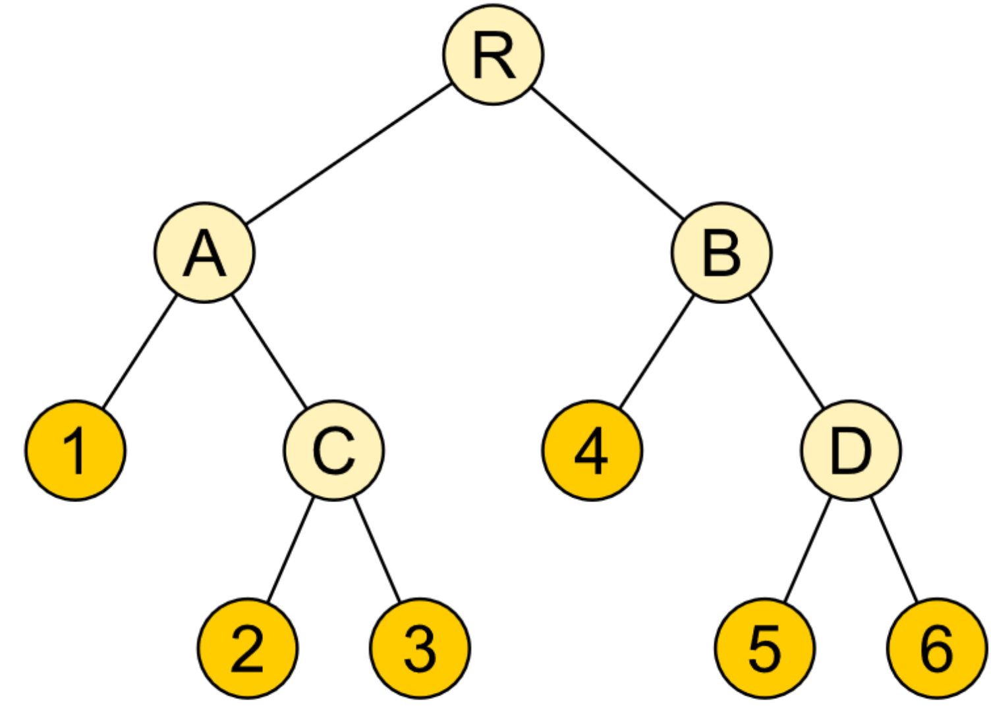
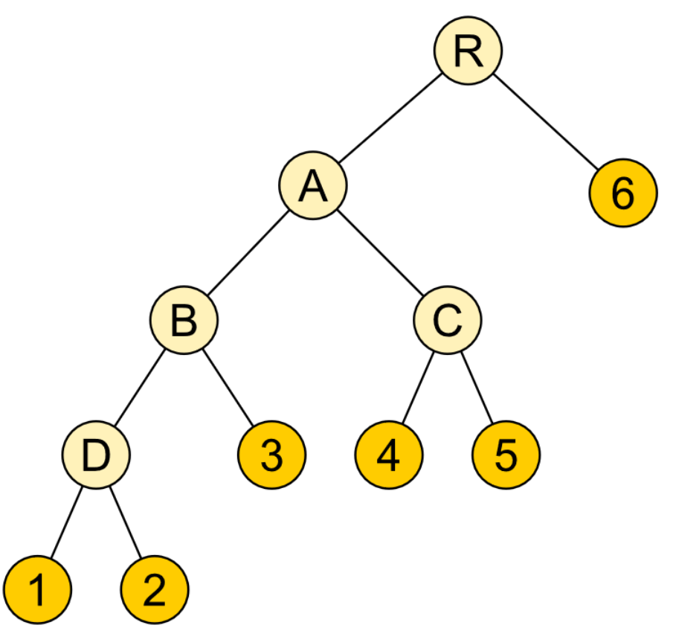
Previous Work
LBVH
Incremental construction
Greedy [Goldsmith and Salmon 1987]
Online [Bittner et al. 2015]
Linear BVH [Lauterbach et al. 2009, Karras 2012]
Topological optimization
Treelet restructuring (TRBVH / ATRBVH) [Karras and Aila 2015, Domingues and Pedrini 2015]
Parallel reinsertion [Meister and Bittner 2018]
TRBVH / ATRBVH

Slide 8
Top-Down Construction
Superior quality to other build algorithms [Aila et al. 2013]
Problem: Repeated access of all primitives $O\left(N \text{log} N\right)$
Level 0
Level 1
Level 0
Level 0
Level 2
Level 1
Level 0
Level 0
Level 3
Level 1
Level 0
Level 0
$$⋯$$
$$⋯$$
Level N
Primitive Data

Slide 9
Key Concept: Stochastic Subsets
Primitive subset can preserve high-level structure of a mesh
Needs to be chosen in a representative fashion (e.g., stochastically)
Top-levels of BVH show aggregated behavior of the data

Slide 10
Stochastic Subset BVH Construction
Idea: Operate on subset for first levels to achieve speedup
Subset Sampling
Level 0
Level 0
Level 1
Level 0
Level 1
Level 0
Level 0
Level 0
Level 2
Level 1
Level 0
Level 2
Level 0
Level 1
Level 0
Level 0
Level 3
Level 1
Level 0
Level 3
Level 0
Level 1
Level 0
Level 0
$$⋯$$
$$⋯$$
Level N
Primitives Insertion
$$⋯$$
Top-down construction
Level N
Notes:
Fixed subset size!

Slide 11
Stochastic Subset BVH Construction
Idea: Operate on subset for first levels to achieve speedup
Subset Sampling
Level 0
Level 0
Level 1
Level 0
Level 1
Level 0
Level 0
Level 0
Level 2
Level 1
Level 0
Level 2
Level 0
Level 1
Level 0
Level 0
Level 3
Level 1
Level 0
Level 3
Level 0
Level 1
Level 0
Level 0
$$⋯$$
$$⋯$$
Level N
Primitives Insertion
$$⋯$$
Top-down construction
Level N

Slide 12
Subset Sampling
Requirements
Follow primitive distribution
Selection proportional to primitive size
Guaranteed selection of large primitives
→ Combination of Spatial Ordering, Importance Sampling & Stratification

Slide 13
Subset Sampling
Stratum
→ Combination of Spatial Ordering, Importance Sampling & Stratification
Notes:
Use diagonal, worked best over e.g. area

Slide 14
Subset Sampling
Stratum
→ Combination of Spatial Ordering, Importance Sampling & Stratification
Notes:
Use diagonal, worked best over e.g. area

Slide 15
Subset Sampling
Weight clampling
In the paper:
Weight clampling
Defensive sampling
Defensive sampling
Notes:
Use diagonal, worked best over e.g. area

Slide 16
Varying Subset Size .
Colored: Subset Primitives; Color: Spatial Ordering .

Slide 17
Stochastic Subset BVH Construction
Idea: Operate on subset for first levels to achieve speedup
Subset Sampling
Level 0
Level 0
Level 1
Level 0
Level 1
Level 0
Level 0
Level 0
Level 2
Level 1
Level 0
Level 2
Level 0
Level 1
Level 0
Level 0
Level 3
Level 1
Level 0
Level 3
Level 0
Level 1
Level 0
Level 0
$$⋯$$
$$⋯$$
Level N
Primitives Insertion
$$⋯$$
Top-down construction
Level N

Slide 18
Stochastic Subset BVH Construction
Idea: Operate on subset for first levels to achieve speedup
Subset Sampling
Level 0
Level 0
Level 1
Level 0
Level 1
Level 0
Level 0
Level 0
Level 2
Level 1
Level 0
Level 2
Level 0
Level 1
Level 0
Level 0
Level 3
Level 1
Level 0
Level 3
Level 0
Level 1
Level 0
Level 0
$$⋯$$
$$⋯$$
Level N
Primitives Insertion
$$⋯$$
Top-down construction
Level N

Slide 19
Primitives Insertion
For each primitive, find best leaf to insert into
Subset BVH
?
Notes:
Try to minimize increase of sah cost

Slide 20
Primitives Insertion
Use approximate neighborhood [Meister et al. 2017]
Subset BVH
Backreference
Notes:
Tested against brute force search

Slide 21
Subset .

Slide 22
Leaf node selection

Slide 23
Stochastic Subset BVH Construction
Idea: Operate on subset for first levels to achieve speedup
Subset Sampling
Level 0
Level 0
Level 1
Level 0
Level 1
Level 0
Level 0
Level 0
Level 2
Level 1
Level 0
Level 2
Level 0
Level 1
Level 0
Level 0
Level 3
Level 1
Level 0
Level 3
Level 0
Level 1
Level 0
Level 0
$$⋯$$
$$⋯$$
Level N
Primitives Insertion
$$⋯$$
Top-down construction
Level N

Slide 24
Evaluation

Slide 25
Environment
Intel® Alchemist A770 GPU (32 Xe cores).
Intel® Core i5 9600K @ 3.7 GHz
16GB DDR4 RAM
Ubuntu 20.04 LTS
oneAPI DPC++ / SYCL
Subset size of 20%

Slide 26
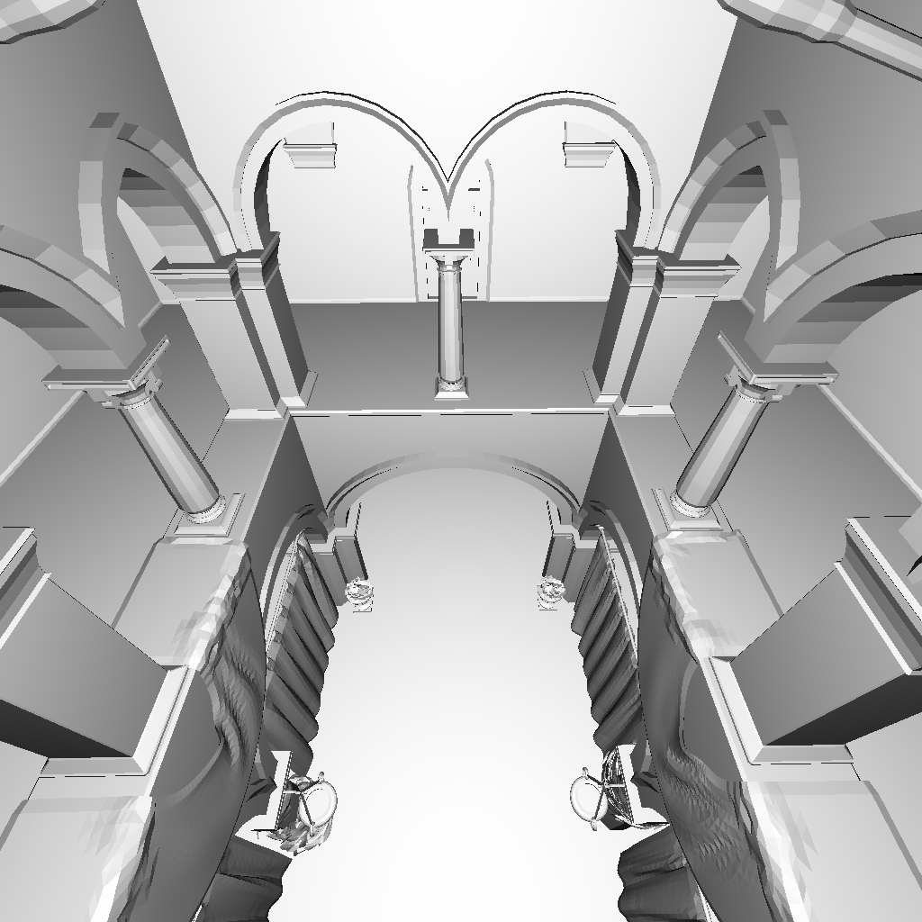
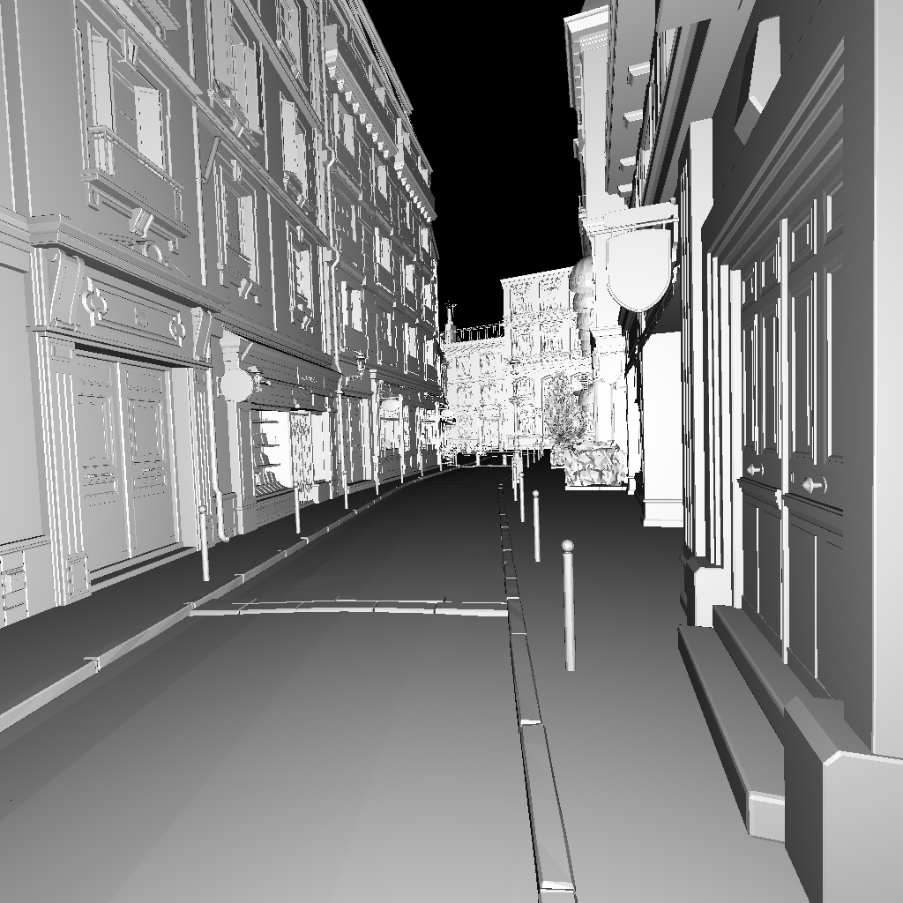
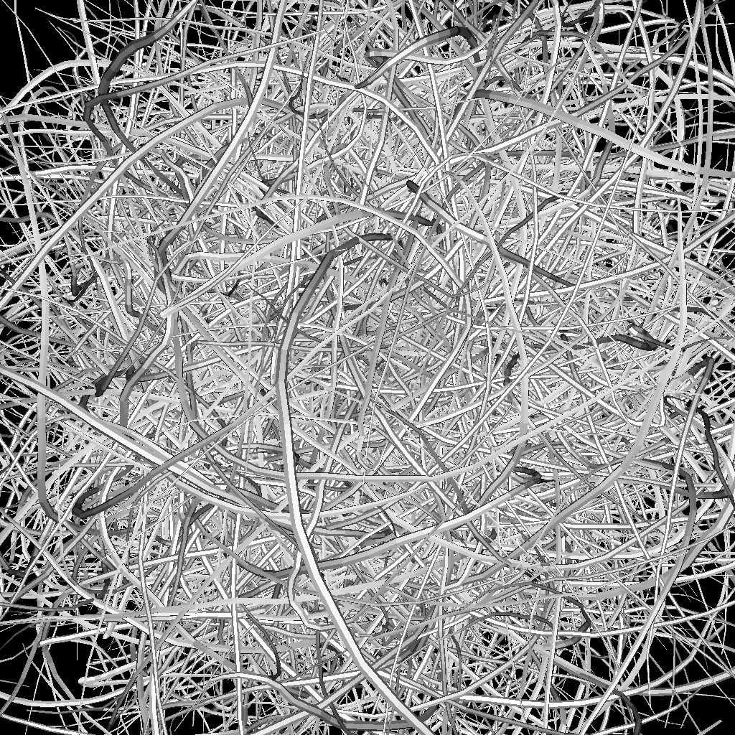
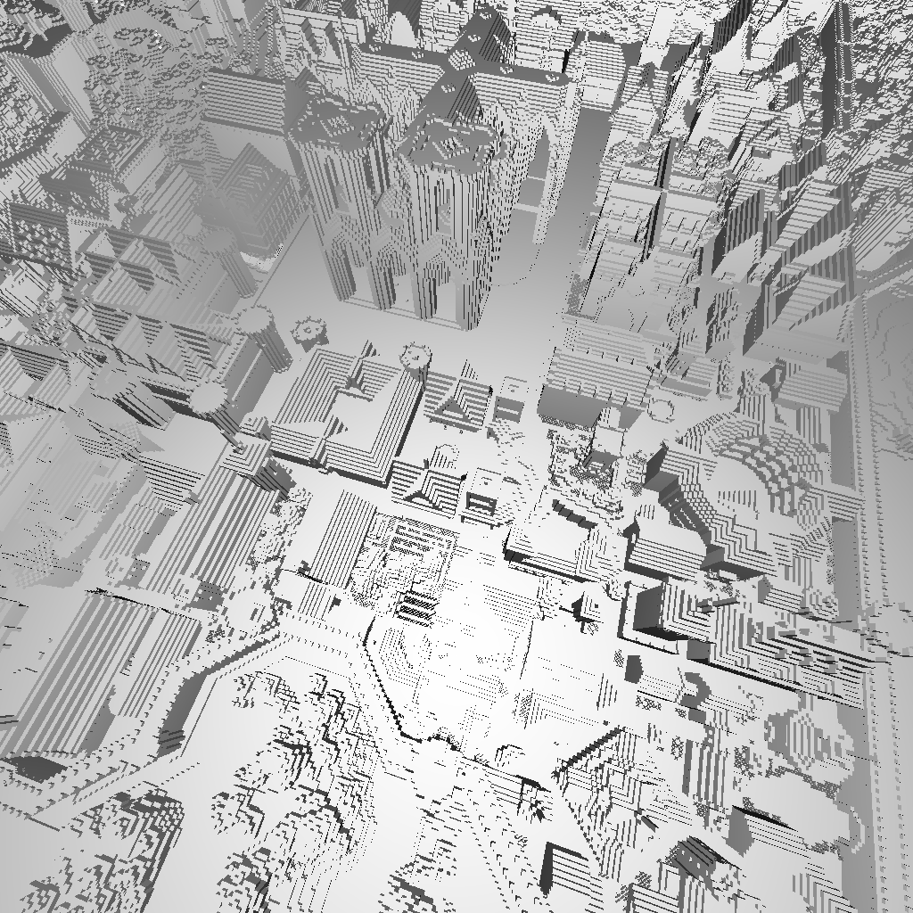
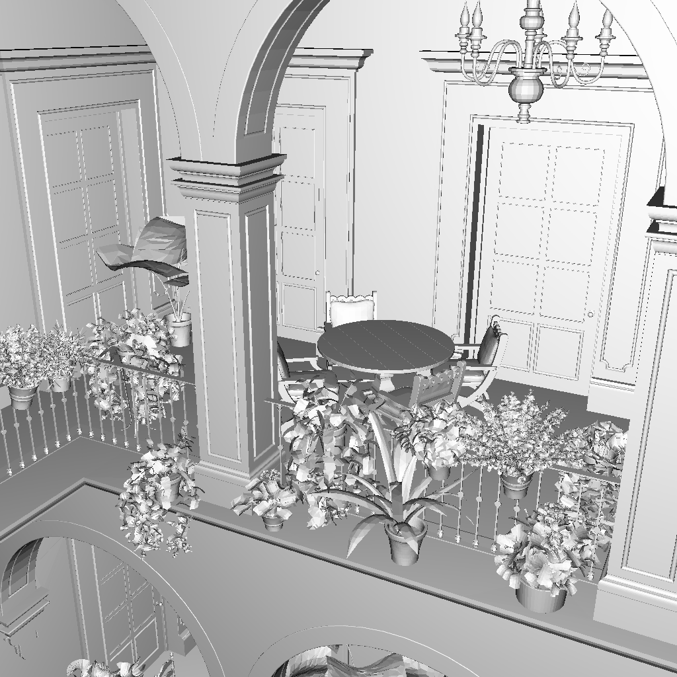
Crytek Sponza (279K) .
Bistro (1.8M) .
Scenes
Hairball (2.9M) .
Crown (4.9M) .
Rungholt (6.7M) .
San Miguel (7.9M) .

Slide 27
Compared Builders
GPU implementation of top-down binned SAH builder [Wald 2007]
Also used as interior builder
Other state of the art builders:
LBVH
PLOC / PLOC++
TRBVH / ATRBVH

Slide 28
Binary BVH Host Build Time (ms)
Better ↓

Slide 29
Quality Metric: Binary BVH SAH Cost
Better ↓
Notes:
Generally outperform the other builders and stay close to Binned

Slide 30
Hardware Ray Throughput with AO (GRays/s)
Better ↑
Additional conversion to hardware-specific BVH format
Notes:
Mostly outperforming, but in some instances the other builders are faster

Slide 31
Discussion

Slide 32
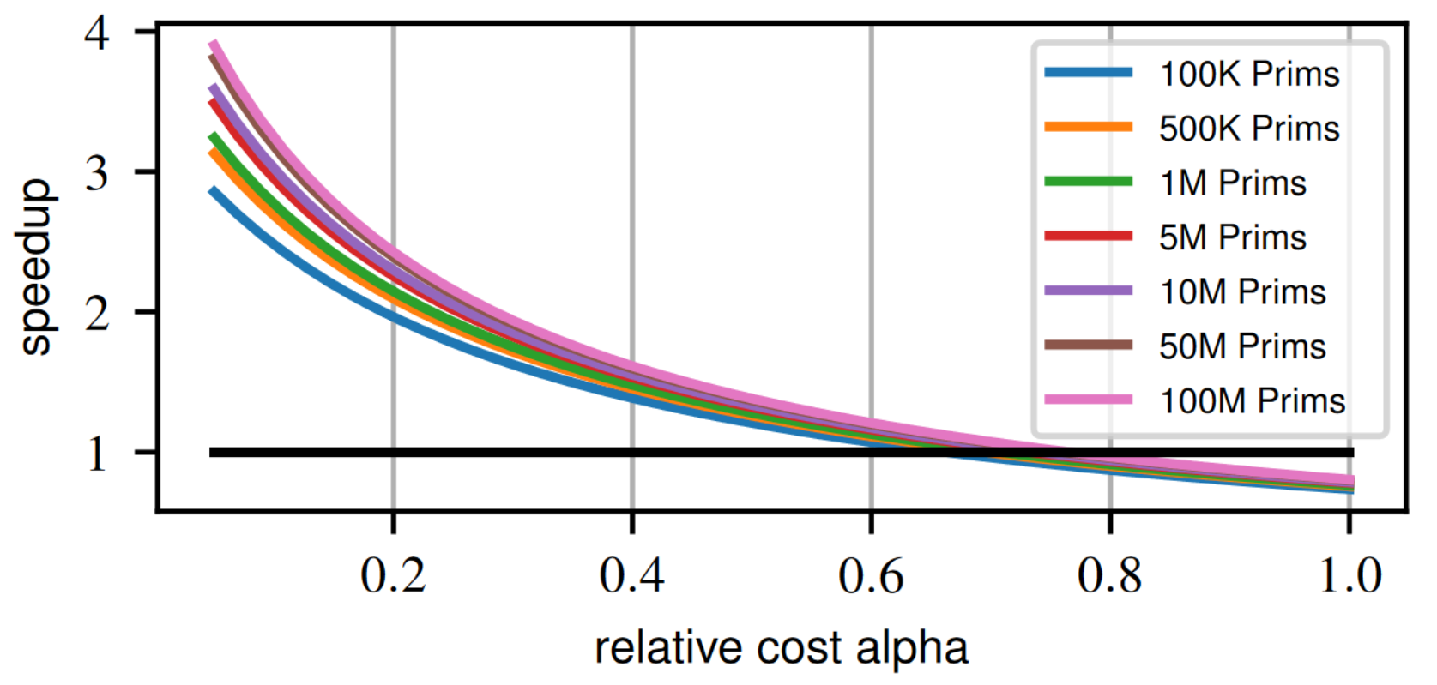
Discussion
The relative overhead impacts the final speedup
Relative Overhead
Notes:
Expected speedup
Limited, depends on overhead and primitive count

Slide 33
Discussion
PLOC Complexity
Currently benefits $O\left(N \text{log} N\right)$ algorithms
Not directly applicable to $O\left(N\right)$ approaches in its current form
Higher memory footprint for additional buffers
Level 0
Level 1
Level 2
Level 3
Level 4
$$⋯$$
Level K - 1
Level K

Slide 34
Conclusion
New primitive in BVH construction
Now possible to importance sample multiple features of the scene
Retains quality of top-down builder at 1.5x avg. (~1.9x max.) speedup
Reducing the gap to faster builders (e. g. PLOC++)
Untapped theoretical speedup still on the table

Slide 35
https://cg.ivd.kit.edu/stochbvh.php
Thanks for your attention! Questions?
Contact: lorenzo.tessari@intel.com, addis.dittebrandt@kit.edu

Slide 36
Backup

Slide 37
Introduction - Surface Area Heuristic (SAH)
Quantifies intersection cost through bounding box areas
Notes:
good at Isolating disjoint regions

Slide 38
Subset Sampling - Weight Clamping
Ideal
Reality
→ Duplicates

Slide 39
Subset Sampling - Weight Clamping
Before Weight Clamping
After Weight Clamping

Slide 40
Subset Sampling - Weight Clamping
$$\text{clam}\text{p}=\text{stratum}∙\sum_{j}^{N}{\text{min}\left({\text{weight}}_{j},\text{clamp} \right)}$$
$$\text{clam}\text{p}≥\text{stratum}∙\sum_{j}^{N}{\text{min}\left({\text{weight}}_{j},\text{clamp} \right)}$$
$$c\text{lamp} \text{=}{ \text{weight}}_{k}$$
k
$$\sum_{j=0}^{k}{{\text{weight}}_{j}}$$
$$(N−\text{k}\text{) }∙\text{clamp}$$
$$+$$
Find smallest k which satisfies ${\text{weight}}_{k}≤\text{stratum}∙\sum_{j}^{N}{\text{min}\left({\text{weight}}_{j},{\text{weight}}_{k}\right)}$

Slide 41
Subset Sampling - Defensive Sampling
Small, highly tessellated flower in San Miguel.
Forcing some more uniform selection levels the cluster size after insertion.
Cluster size histogram: left max > 35k primitives, right max 500
Notes:
Mixture with uniform distribution, avoids undersampling of clusters of extremely tiny triangles

Slide 42
Primitives Insertion - Metric
$$\text{metric}=\sum_{B ∈ \text{a}\text{ncestors}\left(\text{l}\text{eaf}\right)}{SA\left(B∪P\right)−SA\left(B\right)}$$
Metric: Increase of SAH [Bittner et al. 2013]
Only need to evaluate leaf and ancestor nodes
Search can be parallelized in groups

Slide 43
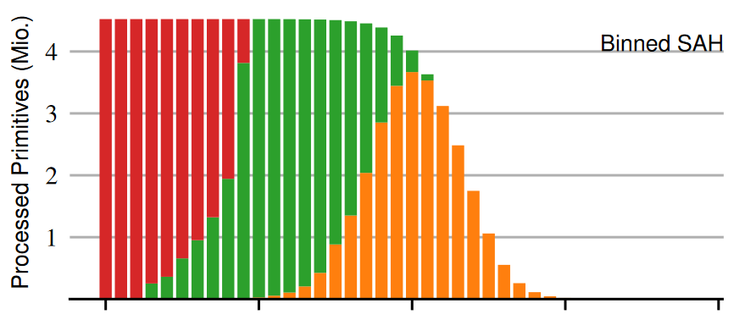
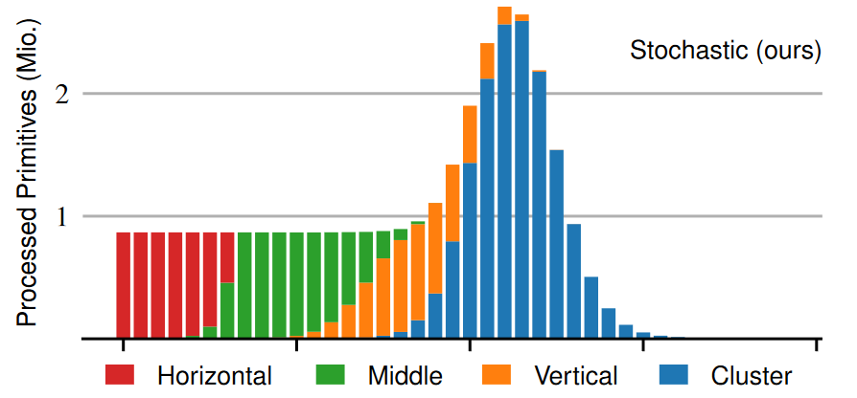
Throughput
much fewer primitives in the first levels …

Slide 44
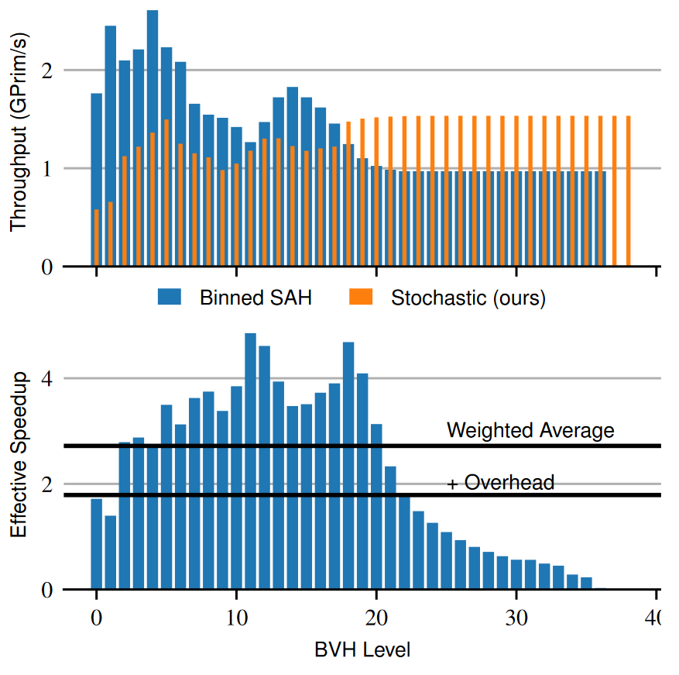
Throughput
much fewer primitives in the first levels ...
… but also less throughput
there is still a net speedup, but less than anticipated

