Slide 1
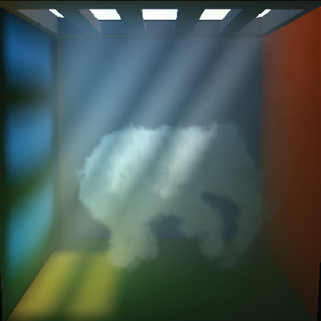
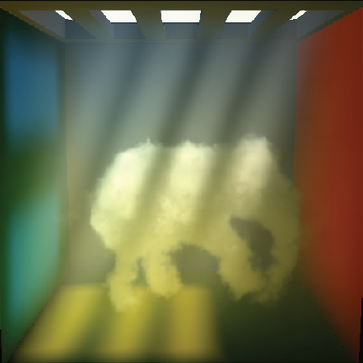
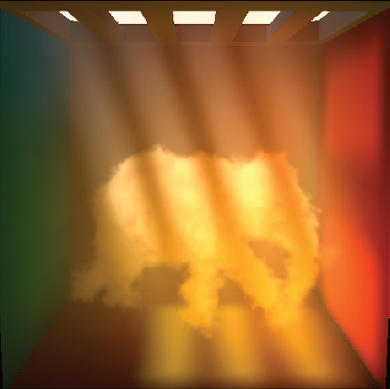
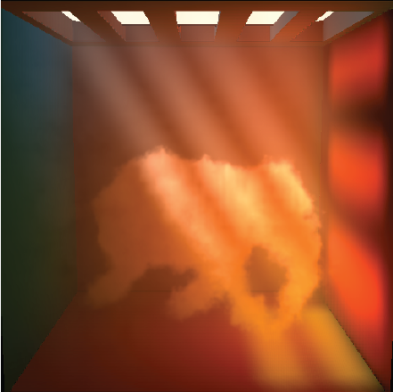
Interactive Light Scattering with Principal-Ordinate Propagation
Graphics Interface 2014
May 7th to 9th, Montreal, Quebec, Canada
Oskar Elek ^{(1,2,3)} Tobias Ritschel ^{(1,2,3)} Carsten Dachsbacher ⁽⁴⁾ Hans-Peter Seidel ^{(1,3)}

Slide 2
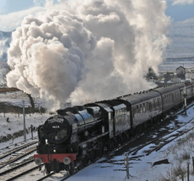
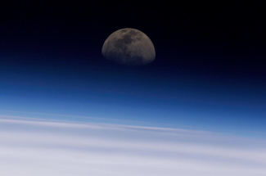
Oskar Elek: Interactive Light Scattering with Principal-Ordinate Propagation
Participating Media

Slide 3
Oskar Elek: Interactive Light Scattering with Principal-Ordinate Propagation
Participating Media

Slide 4
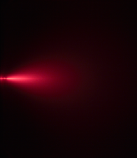
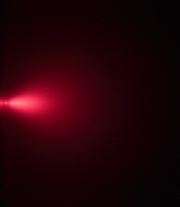
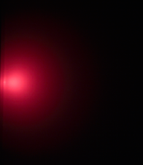
Oskar Elek: Interactive Light Scattering with Principal-Ordinate Propagation
Light Scattering
Radiative Transfer Equation
[Premoze, Ashikhmin, Ramamoorthi, Nayar: Practical Rendering of Multiple Scattering Effects in Participating Media, EGSR, 2004]
Medium density

Slide 5
Oskar Elek: Interactive Light Scattering with Principal-Ordinate Propagation
Wishlist
Interactivity
Dynamicity
Physical plausibility
Generality

Slide 6
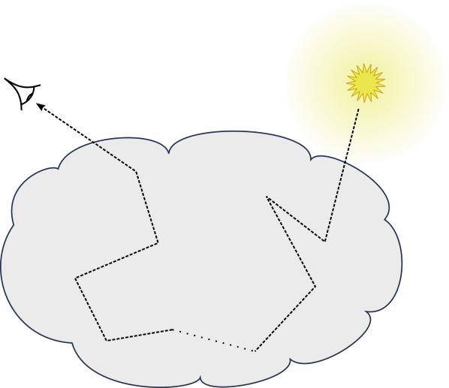
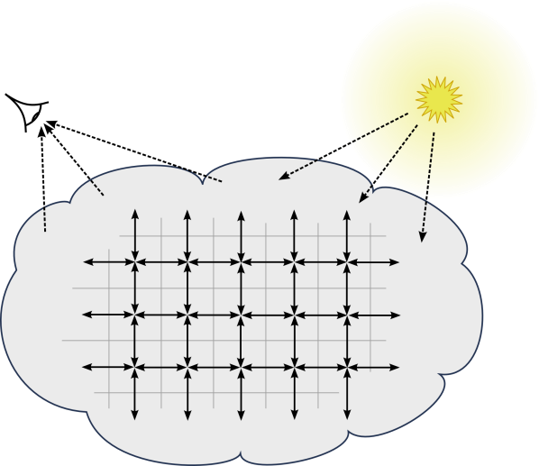
Oskar Elek: Interactive Light Scattering with Principal-Ordinate Propagation
Wishlist
Interactivity
Dynamicity
Physical plausibility
Generality
Monte-Carlo
Finite-Elements
(Path Tracing, Photon Mapping…)
(Diffusion, Discrete-Ordinates, Lattice-Boltzmann…)

Slide 7
Oskar Elek: Interactive Light Scattering with Principal-Ordinate Propagation
Wishlist
Interactivity
Dynamicity
Physical plausibility
Generality
Monte-Carlo
Finite-Elements
(Path Tracing, Photon Mapping…)
(Diffusion, Discrete-Ordinates, Lattice-Boltzmann…)

Slide 8
Oskar Elek: Interactive Light Scattering with Principal-Ordinate Propagation
Finite Elements

Slide 9
Oskar Elek: Interactive Light Scattering with Principal-Ordinate Propagation
Finite Elements

Slide 10
Oskar Elek: Interactive Light Scattering with Principal-Ordinate Propagation
Finite Elements

Slide 11
Oskar Elek: Interactive Light Scattering with Principal-Ordinate Propagation
Finite Elements

Slide 12
Oskar Elek: Interactive Light Scattering with Principal-Ordinate Propagation
Finite Elements
Problems
[Fattal: Participating Media Illumination Using Light Propagation Maps, ACM ToG, 2009]
Ray effect
False scattering

Slide 13
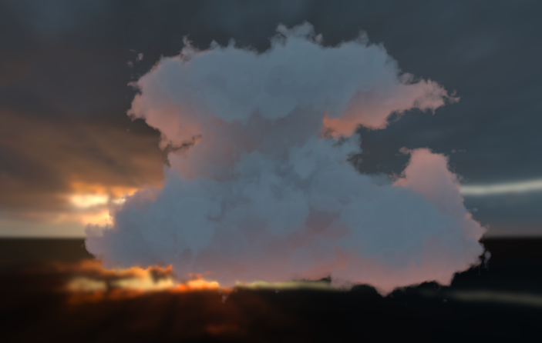
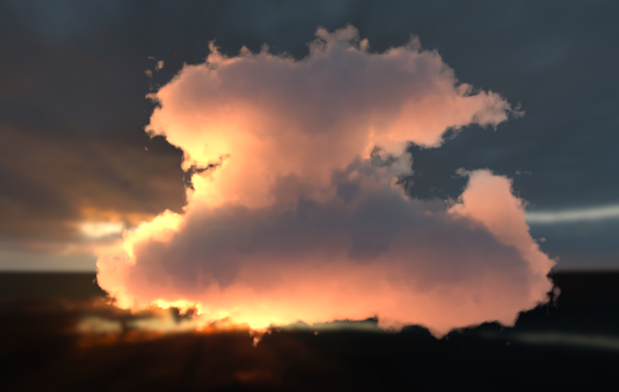
Oskar Elek: Interactive Light Scattering with Principal-Ordinate Propagation
Scattering Anisotropy
Isotropic scattering
Anisotropic scattering

Slide 14
Oskar Elek: Interactive Light Scattering with Principal-Ordinate Propagation
Principal Ordinates
Idea: Instead of solving the transport globally…

Slide 15
Oskar Elek: Interactive Light Scattering with Principal-Ordinate Propagation
Principal Ordinates
Idea: Instead of solving the transport globally…
…separate it, similar to Instant Radiosity

Slide 16
Oskar Elek: Interactive Light Scattering with Principal-Ordinate Propagation
Principal Ordinates
Idea: Instead of solving the transport globally…
…separate it, similar to Instant Radiosity

Slide 17
Oskar Elek: Interactive Light Scattering with Principal-Ordinate Propagation
Principal Ordinates
Idea: Instead of solving the transport globally…
…separate it, similar to Instant Radiosity

Slide 18
Oskar Elek: Interactive Light Scattering with Principal-Ordinate Propagation
Principal Ordinates

Slide 19
Oskar Elek: Interactive Light Scattering with Principal-Ordinate Propagation
Principal Ordinates

Slide 20
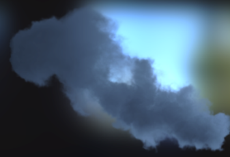
Oskar Elek: Interactive Light Scattering with Principal-Ordinate Propagation
Principal Ordinates

Slide 21
Oskar Elek: Interactive Light Scattering with Principal-Ordinate Propagation
Principal Ordinates
…

Slide 22
Oskar Elek: Interactive Light Scattering with Principal-Ordinate Propagation
Principal Ordinates
Σ
…

Slide 23
Oskar Elek: Interactive Light Scattering with Principal-Ordinate Propagation
Principal Ordinates
Independent!

Slide 24
Oskar Elek: Interactive Light Scattering with Principal-Ordinate Propagation
Propagation Basis
Henyey-Greenstein distribution
g=0
g=0.3
g=0.5

Slide 25
Oskar Elek: Interactive Light Scattering with Principal-Ordinate Propagation
Light Propagation

Slide 26
Oskar Elek: Interactive Light Scattering with Principal-Ordinate Propagation
Light Propagation

Slide 27
Oskar Elek: Interactive Light Scattering with Principal-Ordinate Propagation
Light Propagation

Slide 28
Oskar Elek: Interactive Light Scattering with Principal-Ordinate Propagation
Light Propagation

Slide 29
Oskar Elek: Interactive Light Scattering with Principal-Ordinate Propagation
Light Propagation

Slide 30
Oskar Elek: Interactive Light Scattering with Principal-Ordinate Propagation
Light Propagation

Slide 31
Oskar Elek: Interactive Light Scattering with Principal-Ordinate Propagation
Light Propagation

Slide 32
Oskar Elek: Interactive Light Scattering with Principal-Ordinate Propagation
Light Propagation

Slide 33
Oskar Elek: Interactive Light Scattering with Principal-Ordinate Propagation
Light Propagation

Slide 34
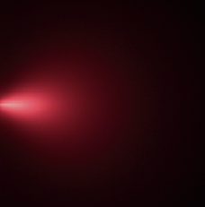
Oskar Elek: Interactive Light Scattering with Principal-Ordinate Propagation
Light Propagation
≈
[Premoze, Ashikhmin, Ramamoorthi, Nayar: Practical Rendering of Multiple Scattering Effects in Participating Media, EGSR, 2004]

Slide 35
Oskar Elek: Interactive Light Scattering with Principal-Ordinate Propagation
Lattice Zoo
DISTANT
LOCAL
VIRTUAL POINT LIGHT

Slide 36
Oskar Elek: Interactive Light Scattering with Principal-Ordinate Propagation
Lattice Zoo
DISTANT
LOCAL
VIRTUAL POINT LIGHT

Slide 37
Oskar Elek: Interactive Light Scattering with Principal-Ordinate Propagation
Lattice Zoo
DISTANT
LOCAL
VIRTUAL POINT LIGHT

Slide 38
Oskar Elek: Interactive Light Scattering with Principal-Ordinate Propagation
Lattice Zoo
DISTANT
LOCAL
VIRTUAL POINT LIGHT

Slide 39
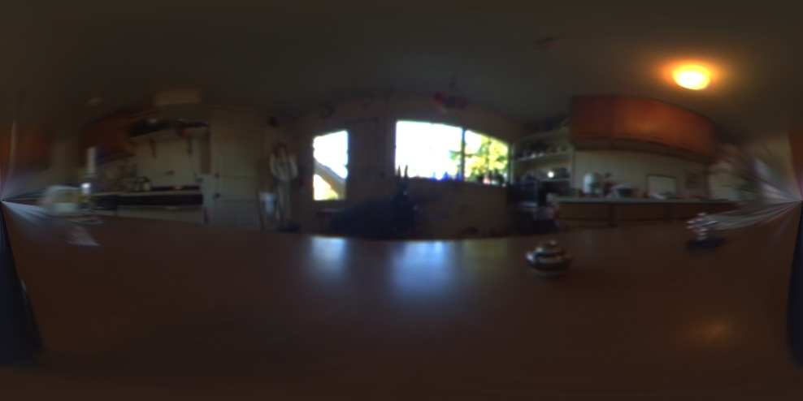
Oskar Elek: Interactive Light Scattering with Principal-Ordinate Propagation
Illumination Sampling

Slide 40
Oskar Elek: Interactive Light Scattering with Principal-Ordinate Propagation
Illumination Sampling

Slide 41
Oskar Elek: Interactive Light Scattering with Principal-Ordinate Propagation
Illumination Sampling

Slide 42
Oskar Elek: Interactive Light Scattering with Principal-Ordinate Propagation
Illumination Sampling

Slide 43
Oskar Elek: Interactive Light Scattering with Principal-Ordinate Propagation
Illumination Sampling

Slide 44
Oskar Elek: Interactive Light Scattering with Principal-Ordinate Propagation
Pipeline
Input:
Medium parametrization
Scene definition
Single directional light

Slide 45
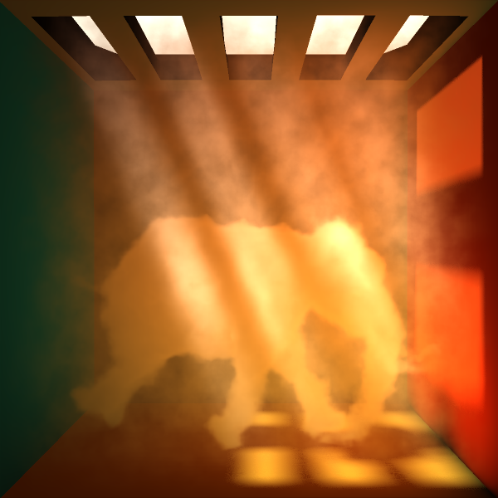
Oskar Elek: Interactive Light Scattering with Principal-Ordinate Propagation
Pipeline
Input:
Medium parametrization
Scene definition
Output:
Final image
Single directional light

Slide 46
Oskar Elek: Interactive Light Scattering with Principal-Ordinate Propagation
Pipeline
Input:
Medium parametrization
Scene definition
Output:
Final image
Single directional light

Slide 47
Oskar Elek: Interactive Light Scattering with Principal-Ordinate Propagation
Pipeline
Input:
Medium parametrization
Scene definition
Output:
Final image
Single directional light

Slide 48
Oskar Elek: Interactive Light Scattering with Principal-Ordinate Propagation
Pipeline
Input:
Medium parametrization
Scene definition
Output:
Final image
Single directional light

Slide 49
Oskar Elek: Interactive Light Scattering with Principal-Ordinate Propagation
Pre-Filtering

Slide 50
Oskar Elek: Interactive Light Scattering with Principal-Ordinate Propagation
Pre-Filtering

Slide 51
Oskar Elek: Interactive Light Scattering with Principal-Ordinate Propagation
Bi-Directionality

Slide 52
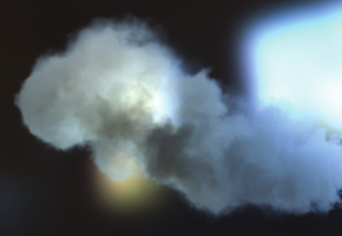
Oskar Elek: Interactive Light Scattering with Principal-Ordinate Propagation
Bi-Directionality

Slide 53
Oskar Elek: Interactive Light Scattering with Principal-Ordinate Propagation
Bi-Directionality

Slide 54
Oskar Elek: Interactive Light Scattering with Principal-Ordinate Propagation
Bi-Directionality

Slide 55
Oskar Elek: Interactive Light Scattering with Principal-Ordinate Propagation
Bi-Directionality

Slide 56
Oskar Elek: Interactive Light Scattering with Principal-Ordinate Propagation
Bi-Directionality

Slide 57
Oskar Elek: Interactive Light Scattering with Principal-Ordinate Propagation
Bi-Directionality

Slide 58
Oskar Elek: Interactive Light Scattering with Principal-Ordinate Propagation
Bi-Directionality

Slide 59
Oskar Elek: Interactive Light Scattering with Principal-Ordinate Propagation
Bi-Directionality

Slide 60
Oskar Elek: Interactive Light Scattering with Principal-Ordinate Propagation
Bi-Directionality

Slide 61
Oskar Elek: Interactive Light Scattering with Principal-Ordinate Propagation
Bi-Directionality

Slide 62
Oskar Elek: Interactive Light Scattering with Principal-Ordinate Propagation
Bi-Directionality

Slide 63
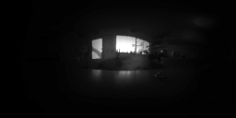
Oskar Elek: Interactive Light Scattering with Principal-Ordinate Propagation
Bi-Directionality

Slide 64
Oskar Elek: Interactive Light Scattering with Principal-Ordinate Propagation
Bi-Directionality

Slide 65
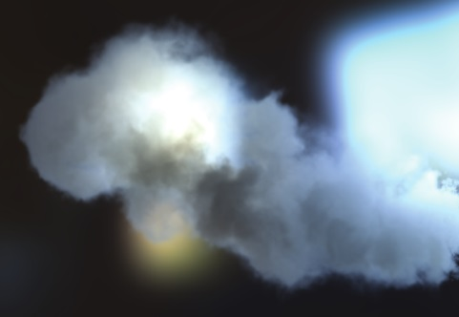
Oskar Elek: Interactive Light Scattering with Principal-Ordinate Propagation
Bi-Directionality

Slide 66
Oskar Elek: Interactive Light Scattering with Principal-Ordinate Propagation
Results
Captured at 9-12 Hz on NVIDIA GeForce GTX 485 Mobile
128²×16 direct scattering grid and 128 VPLs × 8³ radial grid each

Slide 67
Oskar Elek: Interactive Light Scattering with Principal-Ordinate Propagation
Results
Captured at 9-12 Hz on NVIDIA GeForce GTX 485 Mobile
125 principal directions × 16³ grid each

Slide 68
Oskar Elek: Interactive Light Scattering with Principal-Ordinate Propagation
Results
Captured at 9-12 Hz on NVIDIA GeForce GTX 485 Mobile
64 principal directions × 20³ grid each

Slide 69
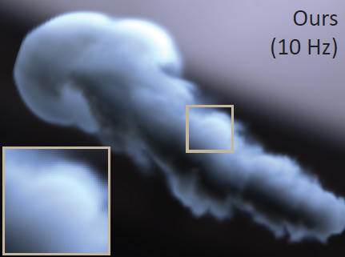
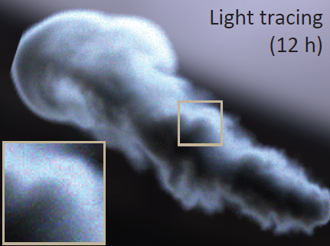
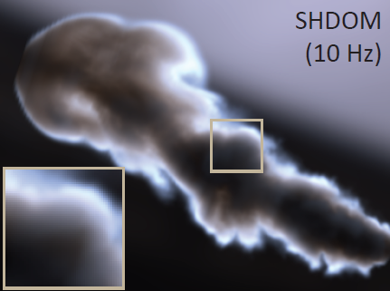
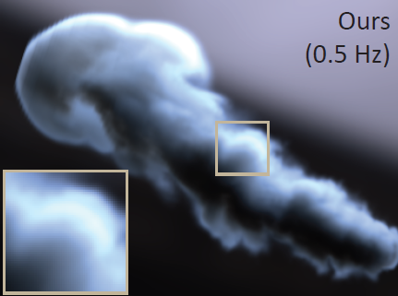
Oskar Elek: Interactive Light Scattering with Principal-Ordinate Propagation
Comparison
Reference and SHDOM

Slide 70
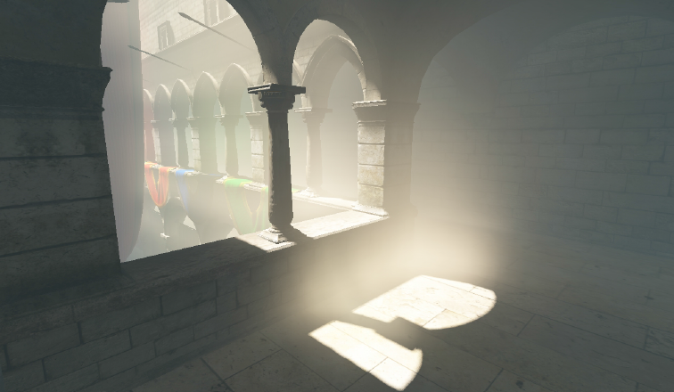
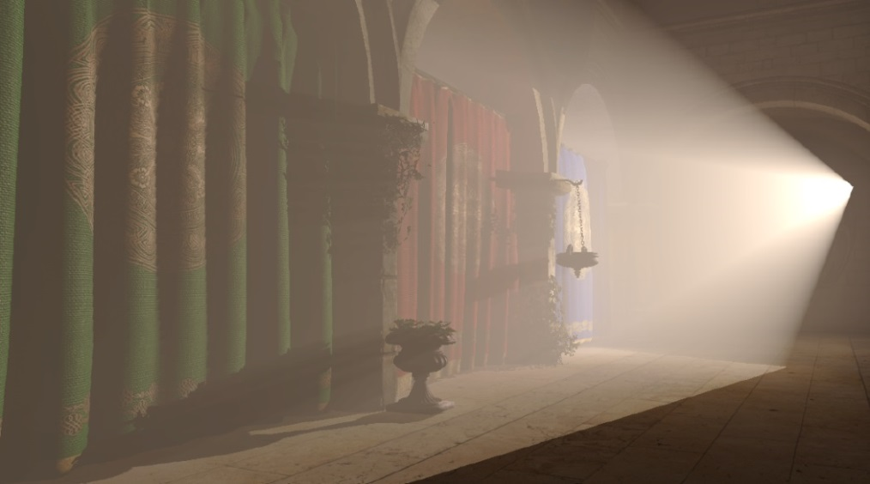
Oskar Elek: Interactive Light Scattering with Principal-Ordinate Propagation
Comparison
Light Propagation Volumes
[Kaplanyan and Dachsbacher: Cascaded Light Propagation Volumes for Real-Time Indirect Illumination, I3D, 2010]
[Billeter, Sintorn, Assarsson: Real-Time Multiple Scattering Using Light Propagation Volumes, I3D, 2012]

Slide 71
Oskar Elek: Interactive Light Scattering with Principal-Ordinate Propagation
Future Work
Temporal coherence

Slide 72
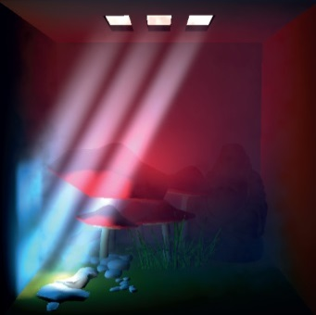
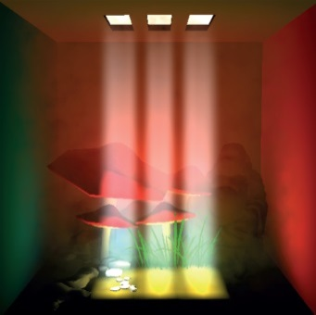
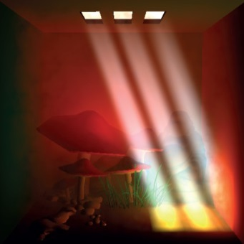
Oskar Elek: Interactive Light Scattering with Principal-Ordinate Propagation
Future Work
Temporal coherence
Surface interaction

Slide 73
Oskar Elek: Interactive Light Scattering with Principal-Ordinate Propagation
Future Work
Temporal coherence
Surface interaction
Convergence
× N

Slide 74
Interactive Light Scattering with Principal-Ordinate Propagation
Oskar Elek ^{(1,2,3)} Tobias Ritschel ^{(1,2,3)} Carsten Dachsbacher ⁽⁴⁾ Hans-Peter Seidel ^{(1,3)}
Thanks
Chuong Nguyen, Peter Vangorp, Yulia Gryaditskaya, Anton Kaplanyan
Anonymous reviewers
You!
More info
tinyurl.com/ScatteringPOP
Google “Principal Ordinate Propagation”

Slide 75
RTE + MPP

